Slide 1
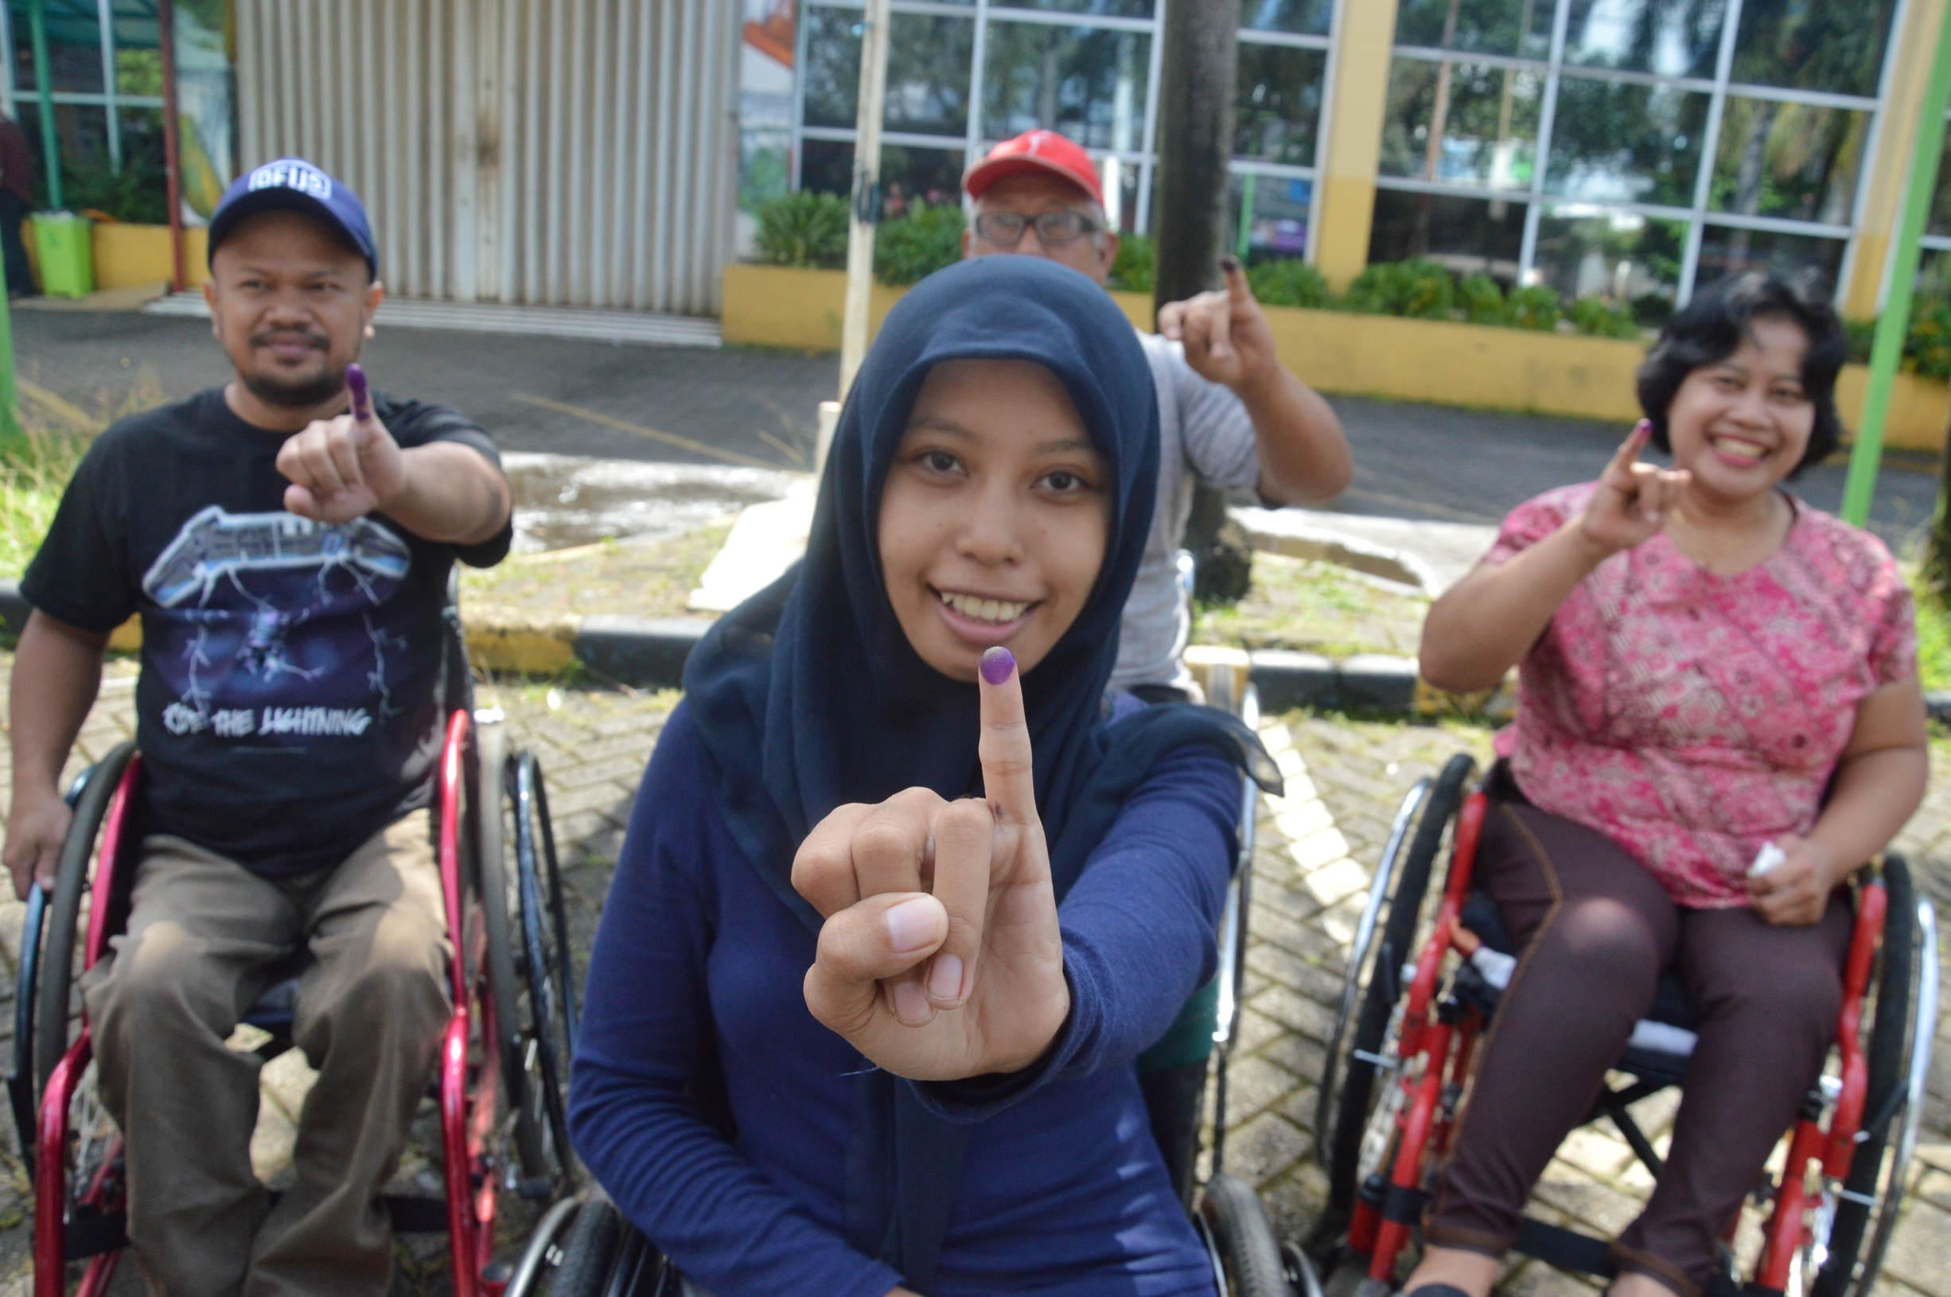
Praktik Terbaik Internasional untuk Pemilu yang Inklusi bagi Penyandang Disabilitas saat COVID-19
Rebecca Aaberg
Inclusion Specialist, IFES

Slide 2
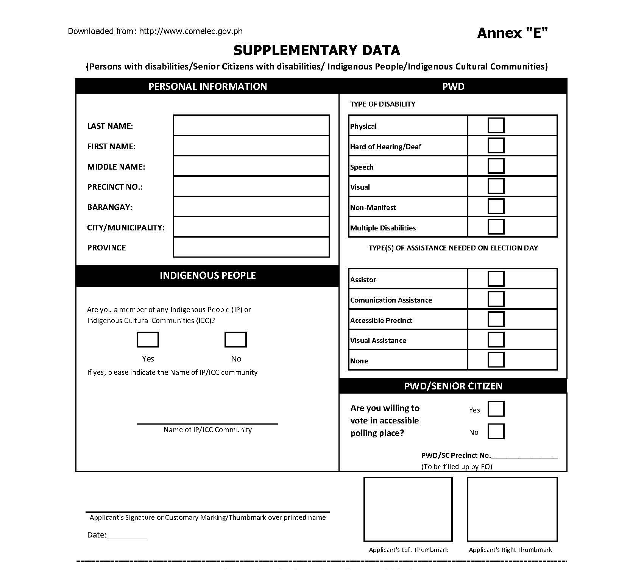
Pendaftaran Pemilih
Notes:
Ask about accommodations – people may have different accommodations now because of COVID-19

Slide 3
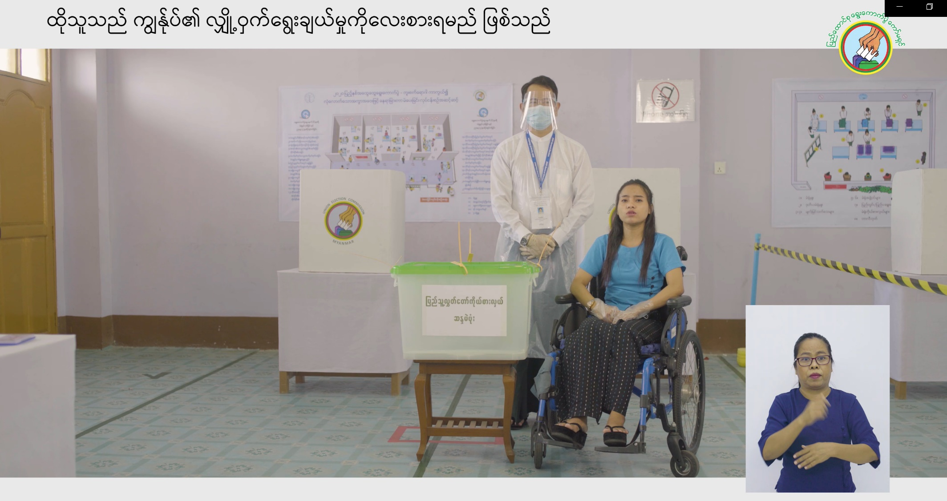
Pemilihan dan Operasional TPS
Notes:
When selecting polling stations/If eliminating polling stations due to COVID-19
Poll worker training

Slide 4
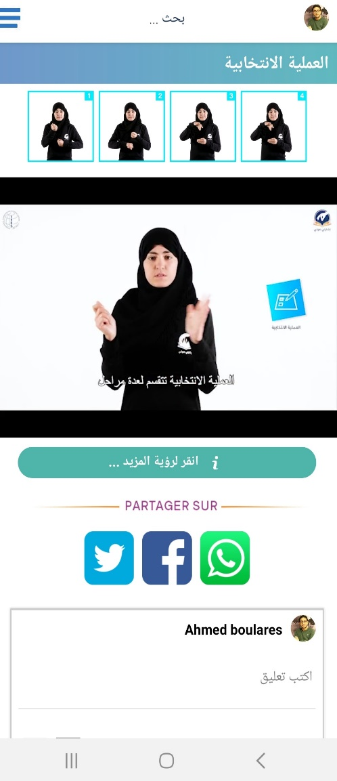


Pendidikan Pemilih
Notes:
Have polling station locations changed? Are there guidelines for keeping physical distance?
Do not use derogatory language about people with psychosocial disabilities to refer to your opponents during your election campaigns. It further stigmatizes people with psychosocial disabilities and can cause distress.

Slide 5
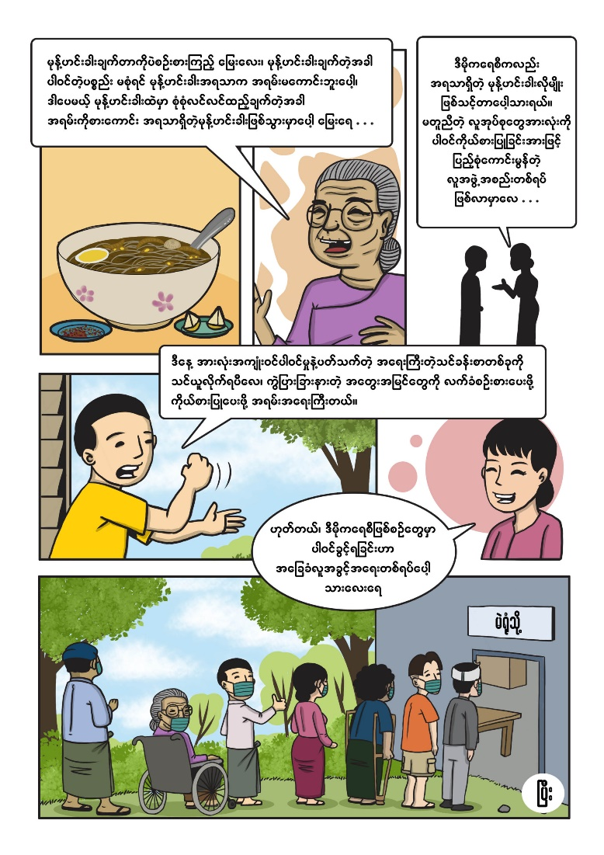
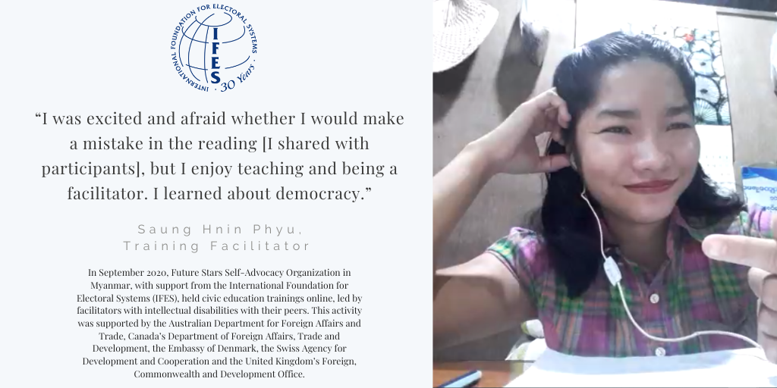
Pendidikan Pemilih
Notes:
Innovative opportunity for voter ed

Slide 6
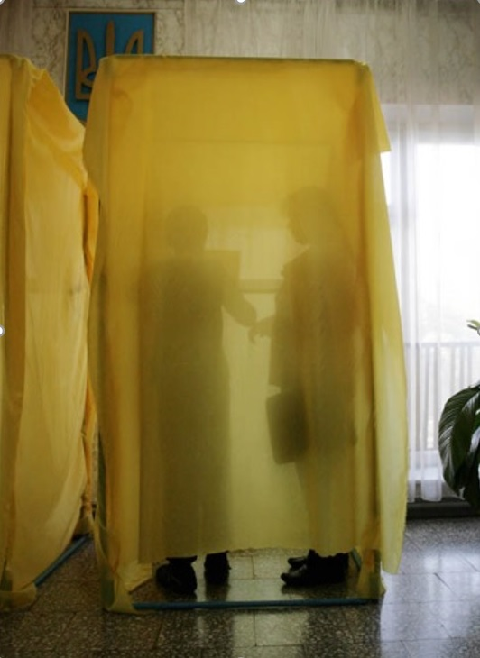
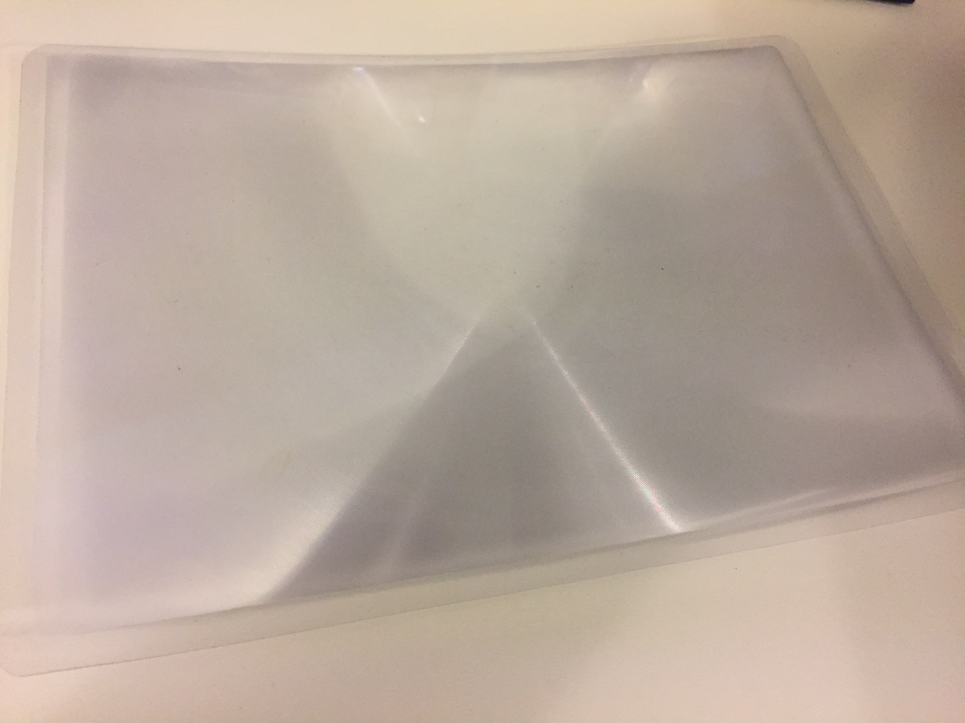
Pemberian Suara
Notes:
Assistants still need access to support voters
Clean assistive devices

Slide 7


Rekomendasi

Slide 8
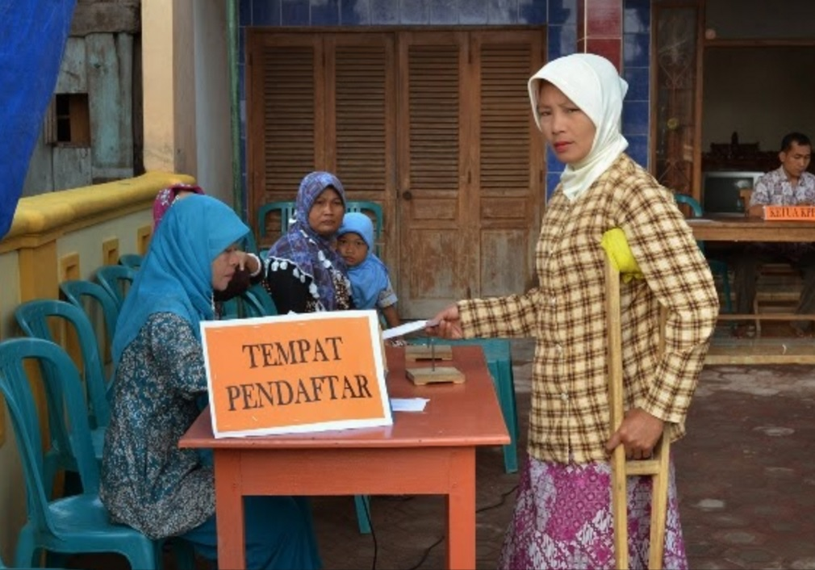
Pertanyaan?

