Slide 1

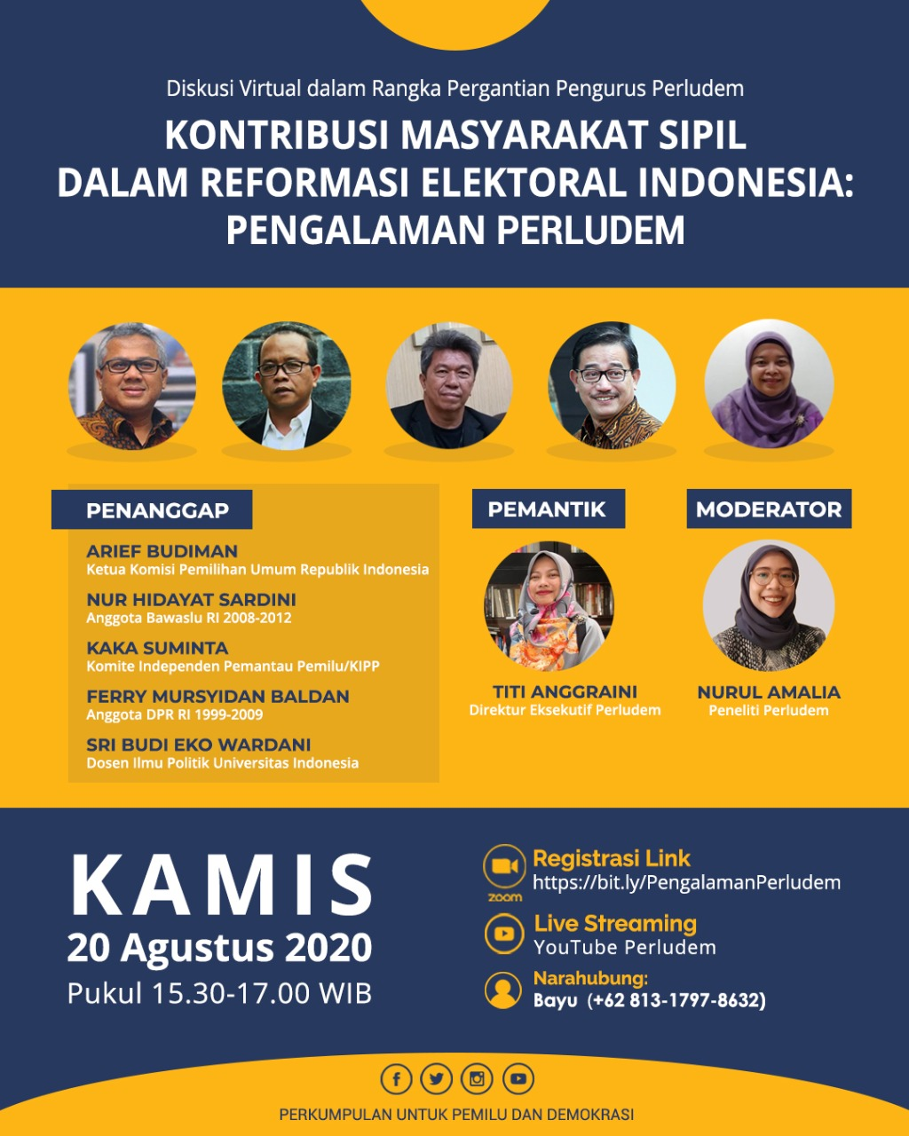
Peranan Sektor Sipil Dalam Melanjutkan Agenda Reformasi Pemilu/Pilkada
Perkumpulan untuk Pemilu & Demokrasi
(PERLUDEM)
Dr. Nur Hidayat Sardini, S. Sos., M. Si.
| Pengajar Pemilu pada Departemen Politik & Pemerintahan, Universitas Diponegoro, Semarang | Anggota Konsorsium Tata Kelola Pemilu | Redaktur Jurnal Electoral Governance |
| Anggota DKPP RI 2012-2017 | Ketua BAWASLU RI 2008-2011 |
Kamis, 20 Agustus 2020
| Mobile phone 081319691969 | Email nhsardini@gmail.com|twitter @nurhidayatsardi | Instagram: nhsardini | YouTube: nhsardini | FaceBook: Nur Hidayat Sardini | Web: www.nurhidayatsardini.com |

Slide 2

I. Pemangku Kepentingan
➤ Pemangku Kepentingan
The stakeholders of an EMB are those individuals, groups, and organizations that have an interest or ‘stake’ in its operations.
They can be classified:
as either primary stakeholders who directly affect or are directly affected by the EMB’s activities, policies, and practices; and
as secondary stakeholders, who have a looser connection with the EMB’s activities.
Genuine and open dialogue with stakeholders can build confidence in the electoral process and trust in the EMB’s activities.
The challenge for EMBs is to take advantage of good relations with election stakeholders.
E
M
B
s
Primary
Stakeholders
Secondary
Stakeholders
Political parties and candidates;
EMB staff;
The executive branch of government;
Legislatures;
Electoral dispute resolution bodies;
The judicial system;
Election monitors and citizen and international election observers;
The media;
The electorate: voters and prospective voters;
CSOs; and
The donor community and electoral assistance agencies.
EMB suppliers;
the public at large; and
regional and international networks.
It is important for an EMB to foster close cooperation with its stakeholders to ensure their support for its policies and programmes and to strengthen their confidence in the EMB’s performance.
Source: Catt, et al (2014)
| Mobile phone 081319691969 | Email nhsardini@gmail.com|twitter @nurhidayatsardi | Instagram: nhsardini | YouTube: nhsardini | FaceBook: Nur Hidayat Sardini | Web: www.nurhidayatsardini.com |

Slide 3
II. Aktor Pemilu
➤ Definisi dan Kategori Pemangku Kepentingan Instansi Pemerintah:
Pemangku kepentingan adalah pihak-pihak dari dalam dan luar organisasi/instansi yang berkepentingan dan berpengaruh terhadap kinerja organisasi/instansi sehingga tercipta tata kelola pemerintahan yang baik.
Pemangku kepentingan internal merupakan khalayak/publik yang menjadi bagian dari kegiatan organisasi atau instansi pemerintah; dan
Pemangku kepentingan eksternal adalah publik yang berada di luar organisasi/instansi yang harus diberi informasi agar dapat membina hubungan dengan baik.
➤ Skema Peta Aktor Pemilu (di) Indonesia
The Public at large
-IV-
Election Monitors/Observer
CSOs
Press/media
-III-
Political parties
-II-
EDR Bodies
-I-
KPU
International networks
The Public at large
Regional networks.
The Public at large
Election Court Institution
Election Court Institution
BAWASLU
DKPP
The Executive Branch of Government
Legislatures
The Electorate: Voters & Prospective Voters
The Public at large
Keterangan:
I: Internal stakeholders — Primary stakeholders;
II: External stakeholders — Secondary stakeholders
III: Outside stakeholders — ‘the public at large’
Source: Permen PAN & RB No. 54 Tahun 2011.
Source: Nur Hidayat Sardini (2019)
| Mobile phone 081319691969 | Email nhsardini@gmail.com|twitter @nurhidayatsardi | Instagram: nhsardini | YouTube: nhsardini | FaceBook: Nur Hidayat Sardini | Web: www.nurhidayatsardini.com |

Slide 4
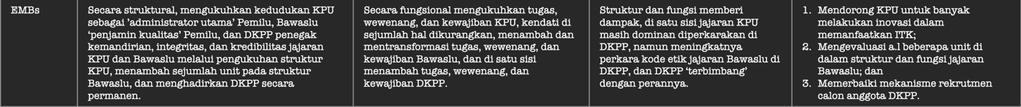
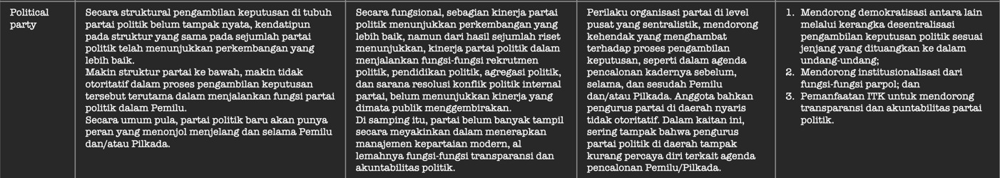
III. Existing Condition: Institusionalisasi Pemilu
Table 1 Capaian Reformasi Pemilu 1999-2019
Source: Nur Hidayat Sardini (2019)
| Mobile phone 081319691969 | Email nhsardini@gmail.com|twitter @nurhidayatsardi | Instagram: nhsardini | YouTube: nhsardini | FaceBook: Nur Hidayat Sardini | Web: www.nurhidayatsardini.com |

Slide 5
IV. Obsession & Resource
➤ Matrix Obsession & Resource
Keterangan:
Subject — Kelompok sosial memiliki cita-cita besar, namun sumber daya terbatas;
Player — Kelompok sosial memiliki cita-cita besar, dan tersedia sumber daya memadai;
Contest setter — Kelompok sosial memiliki sumber daya memadai, namun cita-cita rendah; dan
Crowd — Kelompok sosial memiliki sumber daya rendah, dan cita-cita juga rendah.
High
-1-
Subject
-2-
Player
Obsession
-4-
Crowd
-3-
Contest Setter
Low
Low
High
Resources
Source: Modified by NHS from Crosby et al (2008).
| Mobile phone 081319691969 | Email nhsardini@gmail.com|twitter @nurhidayatsardi | Instagram: nhsardini | YouTube: nhsardini | FaceBook: Nur Hidayat Sardini | Web: www.nurhidayatsardini.com |

Slide 6
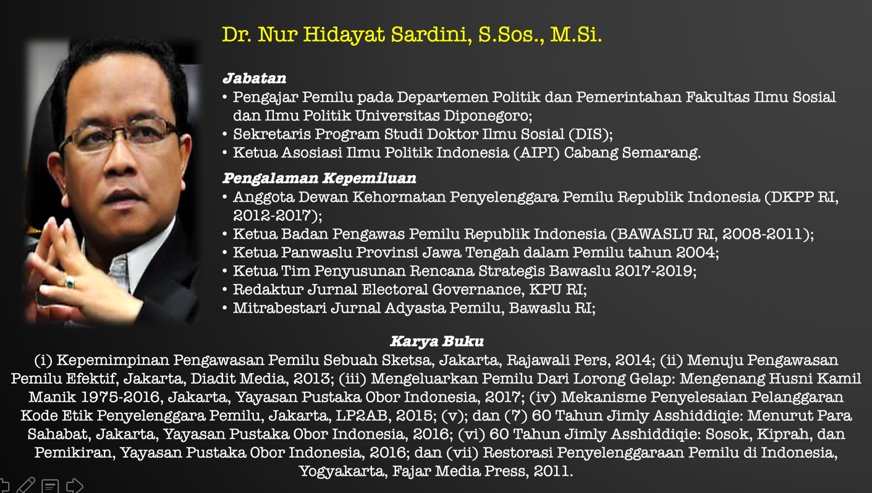
● Profile
| Mobile phone 081319691969 | Email nhsardini@gmail.com|twitter @nurhidayatsardi | Instagram: nhsardini | YouTube: nhsardini | FaceBook: Nur Hidayat Sardini | Web: www.nurhidayatsardini.com |

