Slide 1






Thinking About Voter Participation in COVID-19 Elections
ADHY AMAN
Webinar, 11 August 2020
www.idea.int
@int_IDEA
InternationalIDEA
International IDEA
Notes:
ASSALAMU’ALAIKUM, SALAM SEJAHTERA UNTUK KITA SEMUA
MANY THANKS TO THE ORGANISERS FOR INVITING INTERNATIONAL IDEA TO CONTRIBUTE IN THIS IMPORTANT FORUM

Slide 2
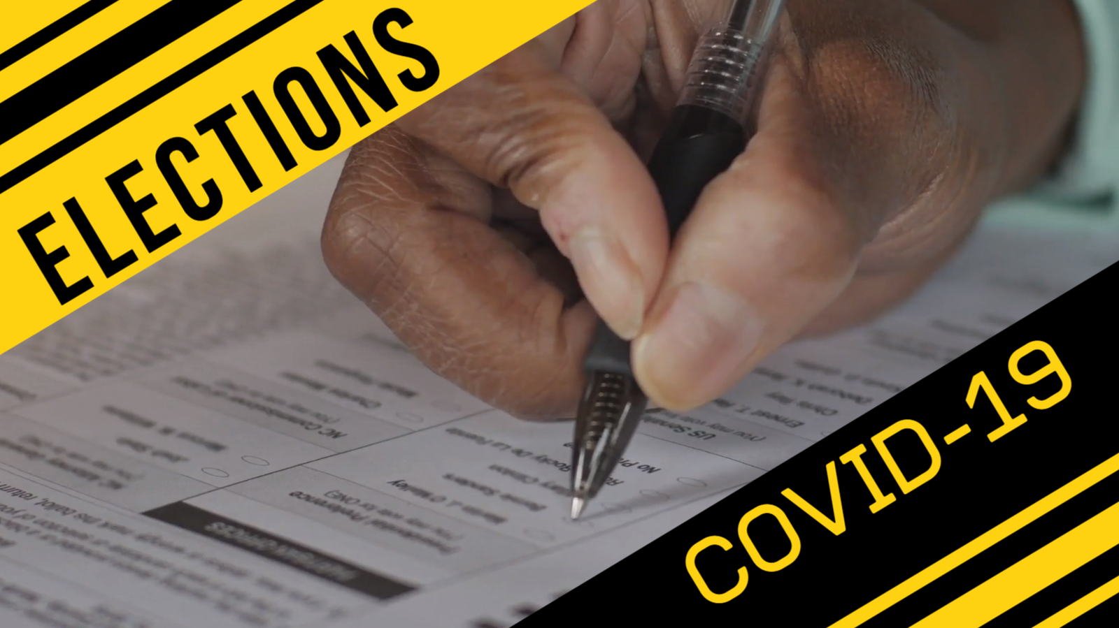

What is the situation?
Notes:
ENTER COVID-19: what is the situation?

Slide 3
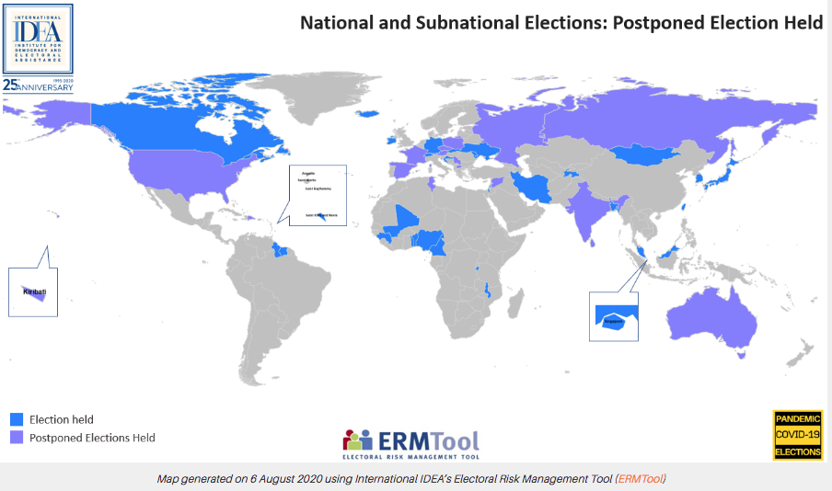

Slide 4
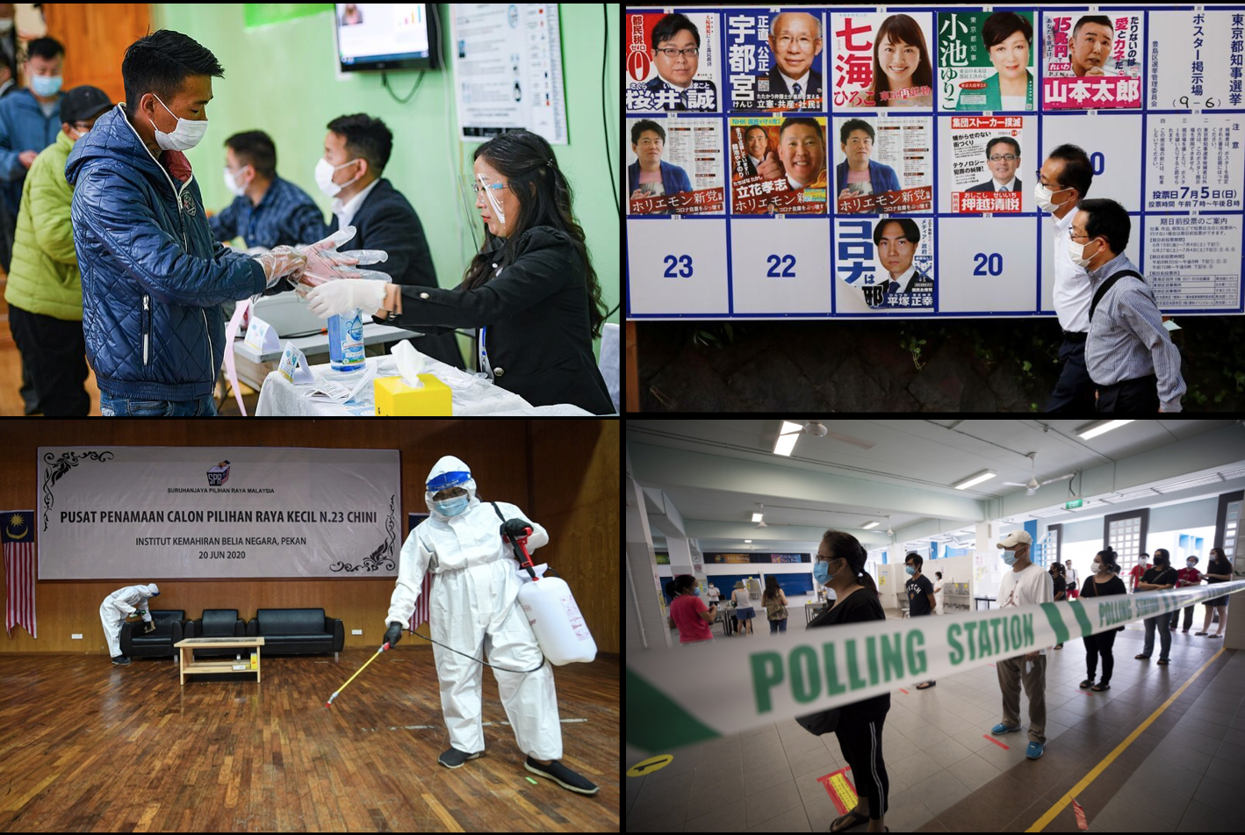
Health & Safety Protocols
From Top Left clockwise: Mongolia [Photo: Friedrich Ebert Stiftung]; Japan [Photo: Reuters]; Singapore [Photo: EPA-EFE]; Malaysia [Photo: Bernama]

Slide 5
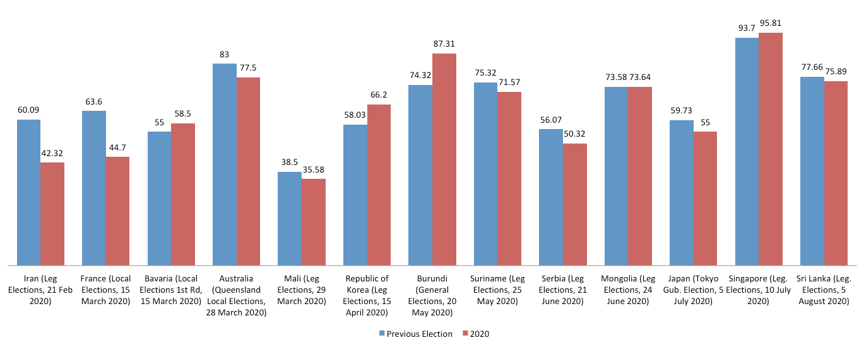
Voter Turnout
Source: International IDEA Voter Turnout Database
Notes:
Voter turnout may be lower: out of the major elections held since March, four had a higher voter turnout:
Bavaria possibly due to postal voting being made available: but postal voting proved controversial in Poland
RoK voters felt the urgency to provide legitimacy to the incumbent government to deal with COVID-19;
an excuse used by the Singaporean PM in calling for 10 July elections
3. Burundi is an exceptional case because the government’s attitude has not been taking COVID-19 seriously and
hardly any tests are being done there, thus there are possibly much less voter awareness about the disease compared to elsewhere
4. Mongolia just happened yesterday and the preliminary turnout is showing very similar to four years ago – NOTE that COVID-19 spread has already been under control for a couple of months there.
2. Certain voters may not be able to vote: in RoK’s case, almost 50% of overseas voters couldn’t vote;
in other contexts, those who are sick with COvID-19 may not be able to vote
3. Incumbents with current de facto powers may be at an advantage:
- in Serbia just a few days ago, the OSCE has come out to say the ruling party had media dominance,
thus affecting voter choice; elections were also held during a state of emergency;
- In Mongolia, there had been a tug of war between the President and the parliament where the President
belongs to the minor party in parliament. The President wanted to postpone the elections,
but the majortiy party in parliament wanted to go ahead;
some speculated because the situation is advantageous to them
SO, GOING AHEAD OF ELECTIONS IN THIS STATE, RISKS UNDERMINING LEGITIMACY OF THE RESULTS

Slide 6
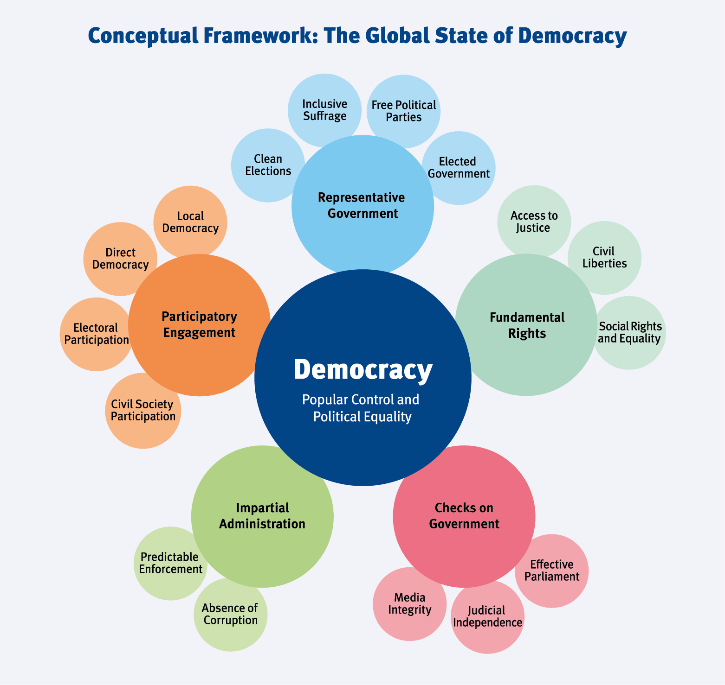
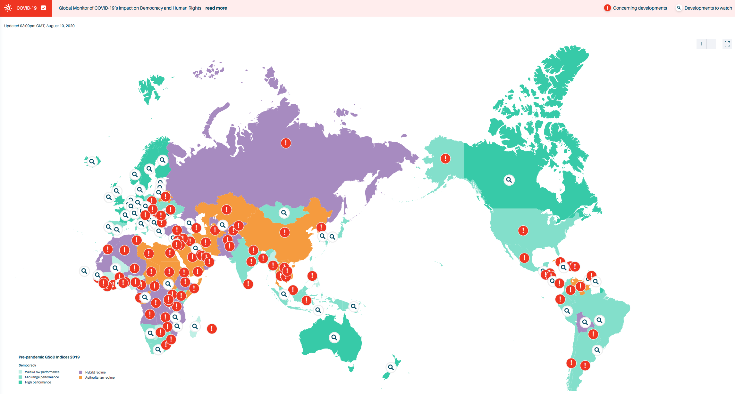
The Global Monitor of COVID-19´s Impact on Democracy and Human Rights

Slide 7
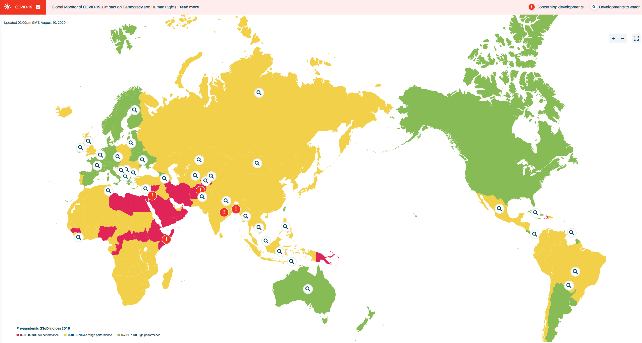
GENDER EQUALITY
AFGHANISTAN:
Afghan women have less access to healthcare and COVID-19 testing, and maternal care and vaccinations have fallen as a result, a survey of Afghan health staff warns.
BANGLADESH:
Women are some of the hardest hit economically by COVID-19, with more than a million garment works laid off, 80 per cent of whom are women. Women domestic workers have also faced unemployment.
INDIA:
There has been an increase in domestic violence against women during the lockdown. Between 23 March and 16 April 2020, i.e. during the first three weeks of the lockdown, 239 complaints of domestic violence were received; 123 such complaints were received in the month leading up to the lockdown.
Notes:
The Gender Equality subcomponent denotes the extent political equality between genders has been realized.

Slide 8
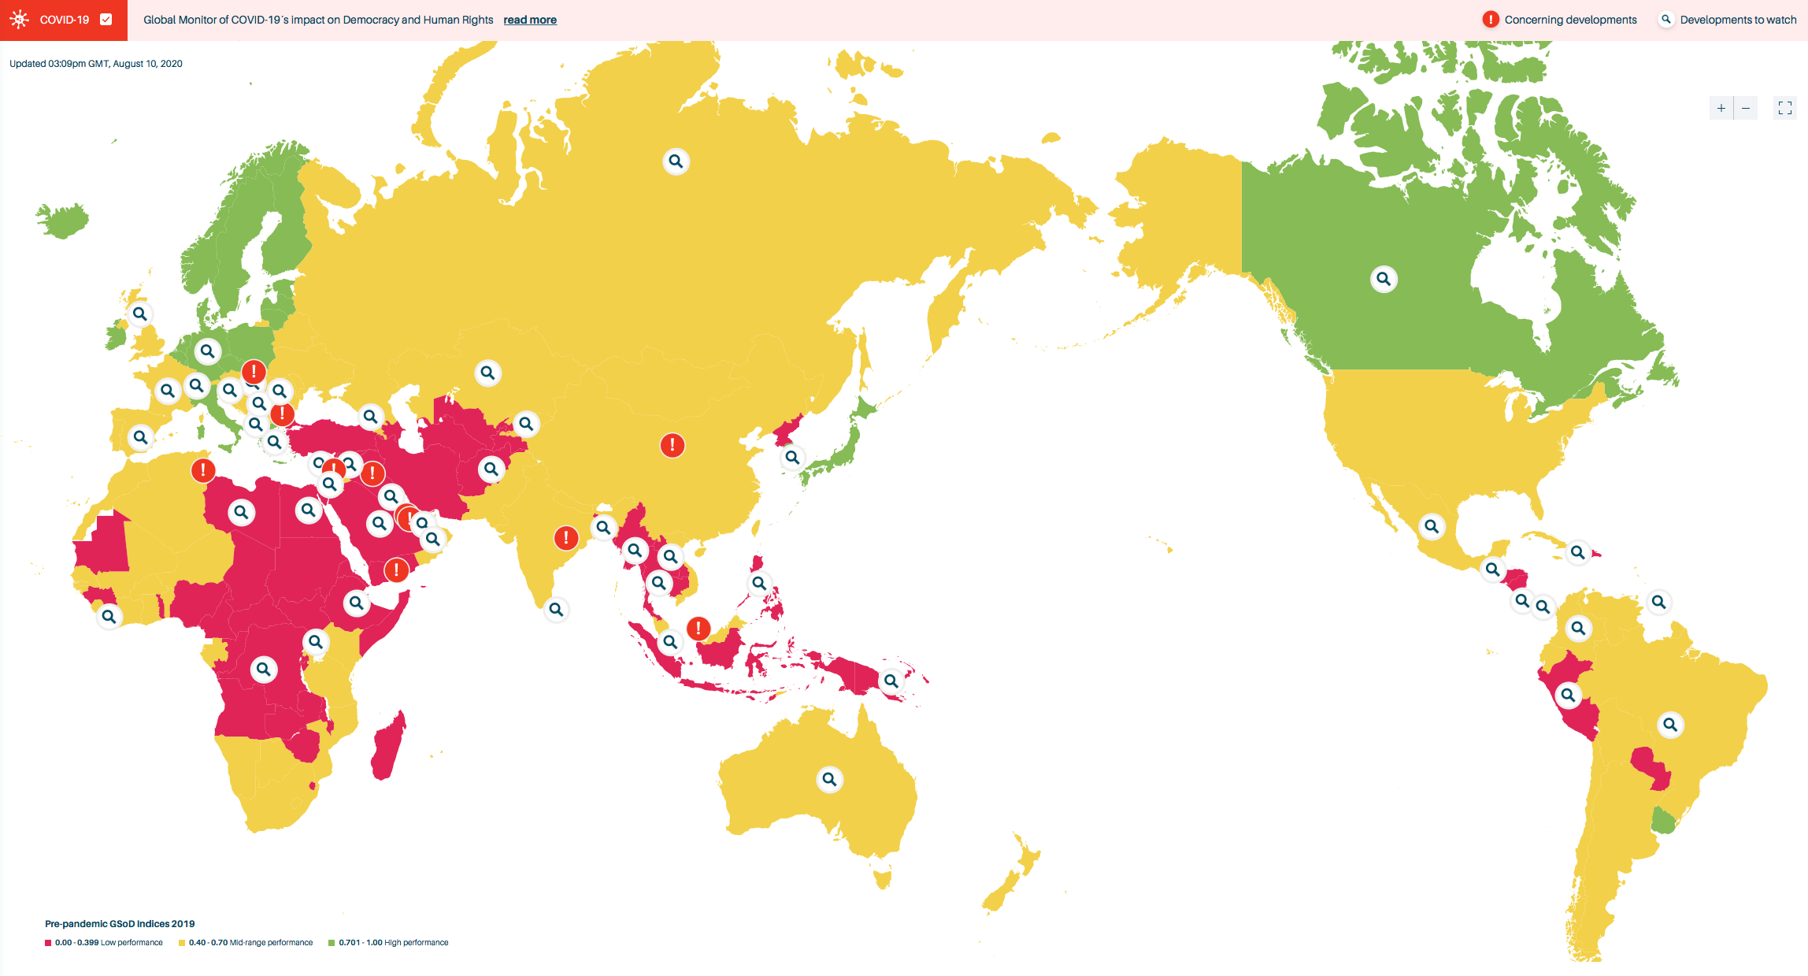
SOCIAL GROUP EQUALITY
CHINA:
In April, Africans in China, and particularly in Guandong Province, were tested and quarantined forcefully for 14 days in an allegedly inhumane manner even without symptoms. Racist attacks were widespread, including evictions from apartments and refusal of entry into
hotels and restaurants.
MALAYSIA:
There have been arrests of hundreds of migrant workers in Kuala Lumpur’s so-called Covid-19 “red zones” where the infection rate is said to be high. The UN has condemned the move.
INDIA:
There have been cases of Muslims being assaulted, harassed and denied medical attention. Some Indian states have also seen spikes in caste-based discrimination and violence during the pandemic. Prime Minister Modi delivered an explicit call for unity in April, stating, 'COVID-19 does not see race, religion, colour, caste, creed, language or border before striking.'
Notes:
2.3.A Social Group Equality This subcomponent measures the extent to which there is social group and class equality in regards to political power and civil liberties.

Slide 9

Things Voters Consider in COVID-19 Elections
Maintenance of their good health;
Preservation of their voting rights & secrecy;
Election of legitimate gov’t.
LET’S VOTE !
Notes:
These would be the goals for EMBs and policy makers to meet.

Slide 10


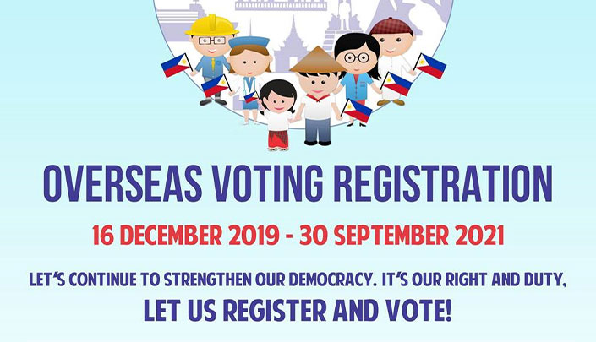
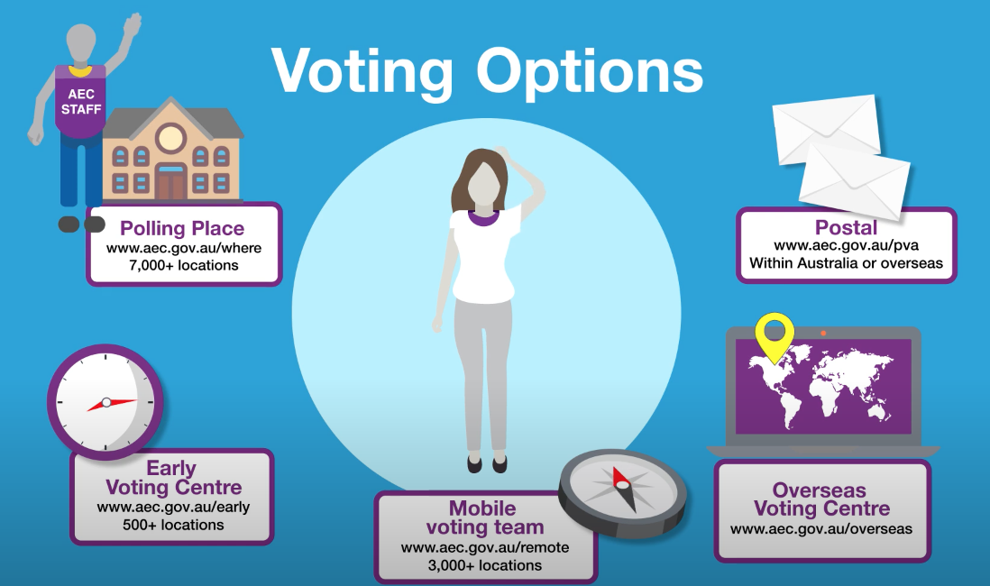

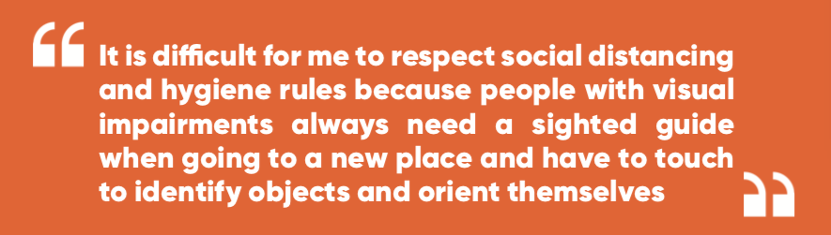
LIMITATIONS ON VOTER ACCESS
Difficulty to vote for PWDs & COVID-19 positive patients
Overseas voters in lockdown countries cannot vote
Certain voting arrangements are not available
UNDP Rapid Assessment of the Socio-Economic Impact of COVID-19 on Persons With Disabilities in Viet Nam (May 2020)
Notes:
COVID-19 patients are isolated, unless there are special provisions that allow them to cast their votes, they would be
Disenfranchised
PWDs, such as blind people and people with limited movements, would require physical assistance from others
2. Overseas voters in lockdown countries cannot vote unless they are able to vote at their homes,
for example through postal voting or online voting;
the Philippines actually had to suspend the voter registration exercise shown by the poster due to the pandemic
3. Certain voting arrangements are not available: eg. The AEC has announced that for the forthcoming PARL by-elections in NSW,
mobile voting for elderly people will not be available – instead they will be offered postal ballots

Slide 11

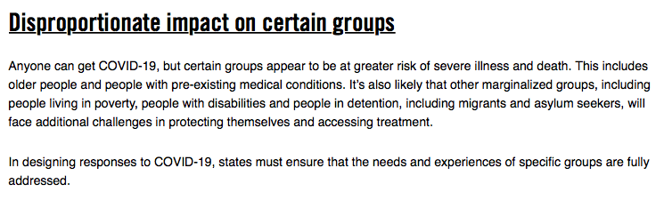
Notes:
Amnesty International has found that certain groups are affected by COVID-19 disproportionately.

Slide 12
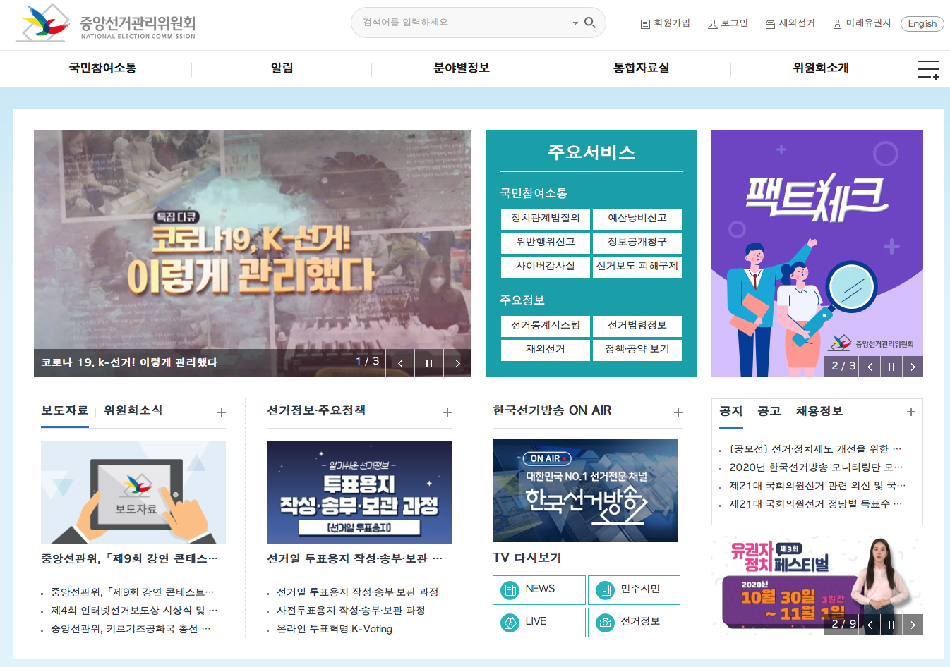
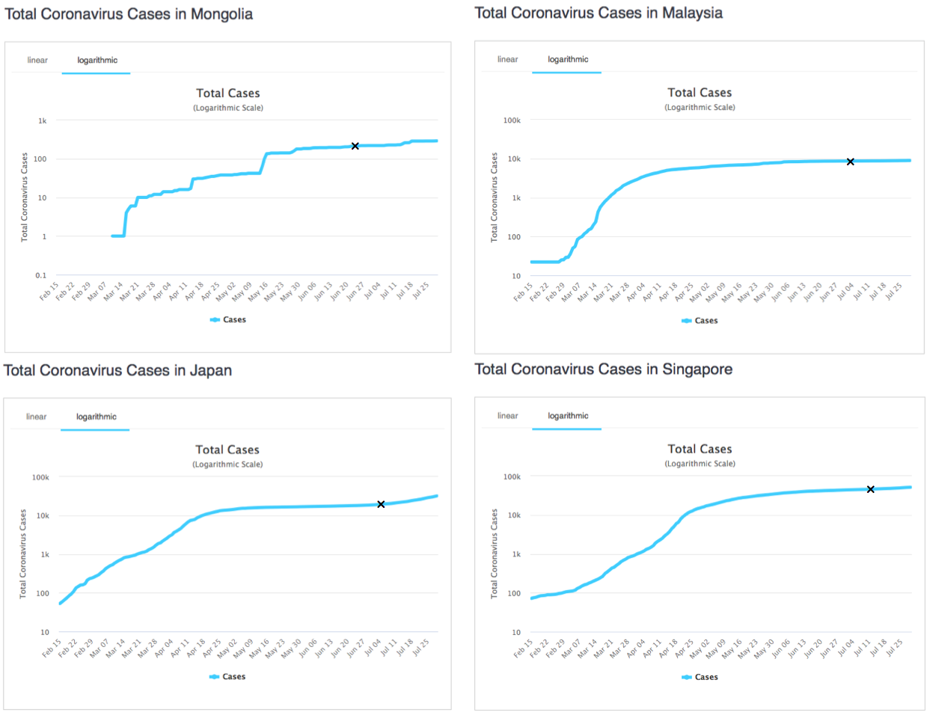
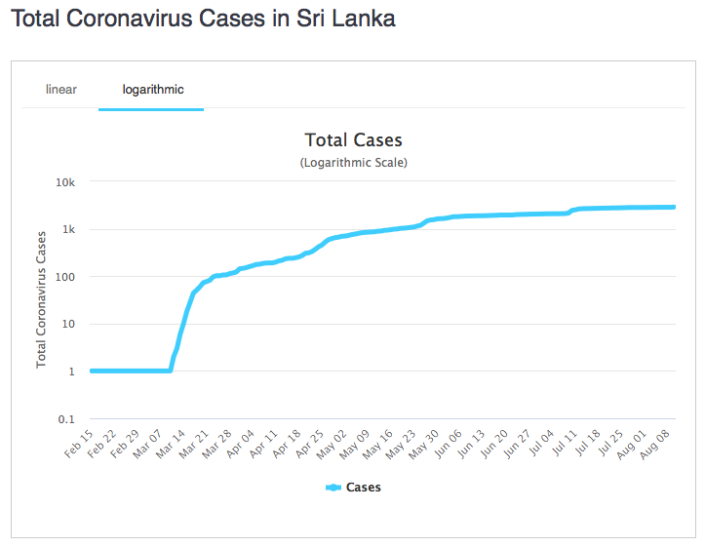
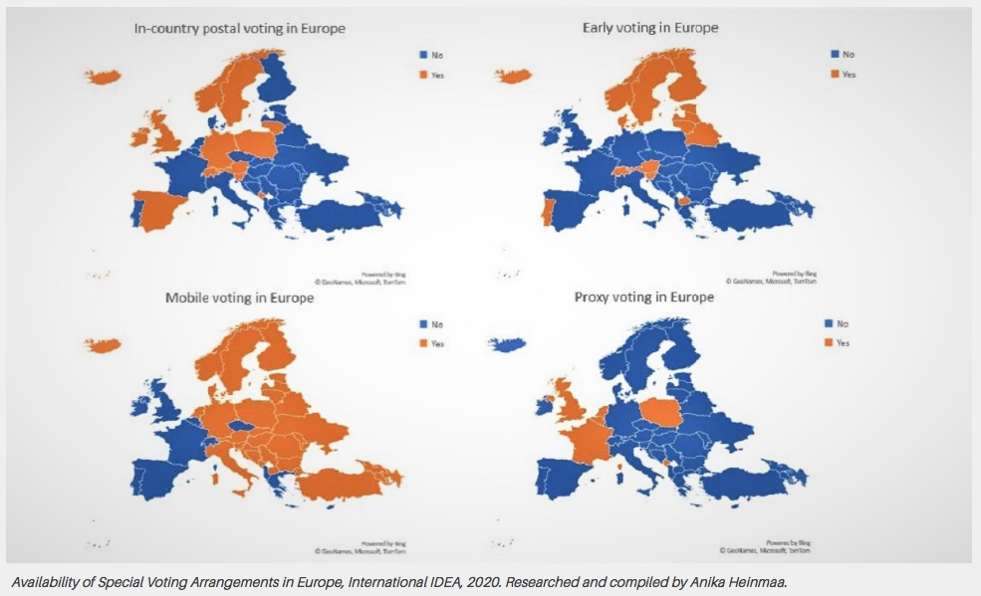
Mitigating Adverse Impacts on Vulnerable Groups
Ensure the ‘curve is flat’
Ensure adequate voter information campaign
Implement special voting arrangements (SVAs) for vulnerable groups
x
Source: Worldometers.info

Slide 13

A.Aman@idea.int
@adhyaman
www.idea.int
@int_IDEA
InternationalIDEA
International IDEA
Notes:
THANK YOU FOR YOUR KIND ATTENTION AND I LOOK FORWARD TO PARTICIPATING IN THE DISCUSSION.

