Slide 1
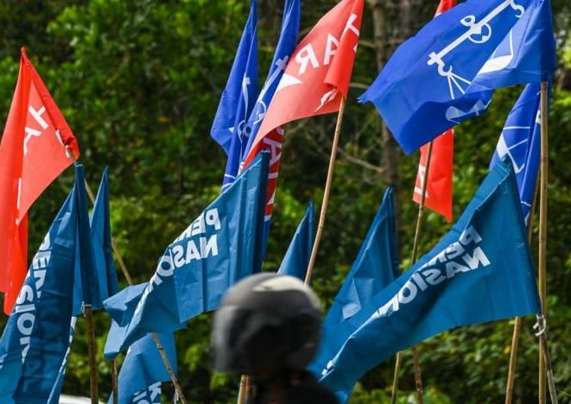
Electoral System Reform and Its Discontents:
Prospects and Setbacks in Malaysia
Ooi Kok Hin & Asraf Sharafi
The Coalition for Clean and Fair Elections (BERSIH)
Indonesia Electoral Reform Forum | December 18-19, 2024

Slide 2

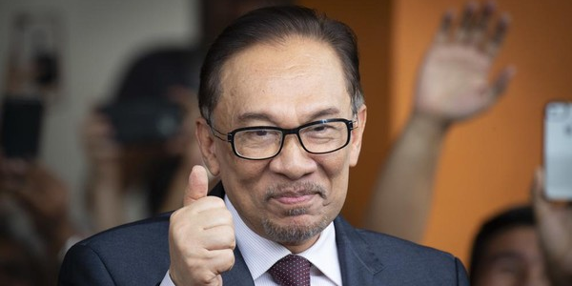
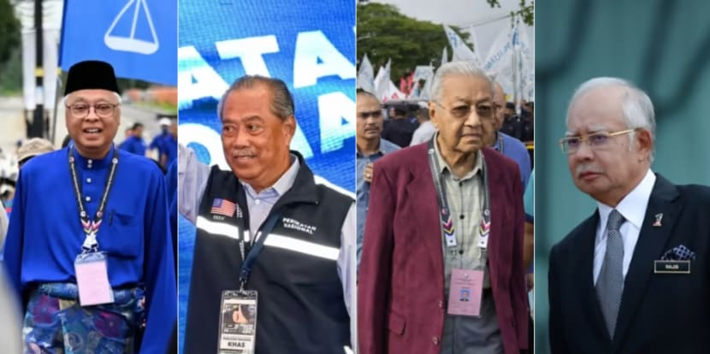
Competitive =/= Fairness
Elections are more competitive, but that does not necessarily mean elections are fairer
  Systematic inequality remains. E.g. Malapportionment has gotten worse, gerrymandering persists.
  Gender representation remain poor (less than 15% of MPs are women)
  Voters have no say in local government and senate appointment

Slide 3
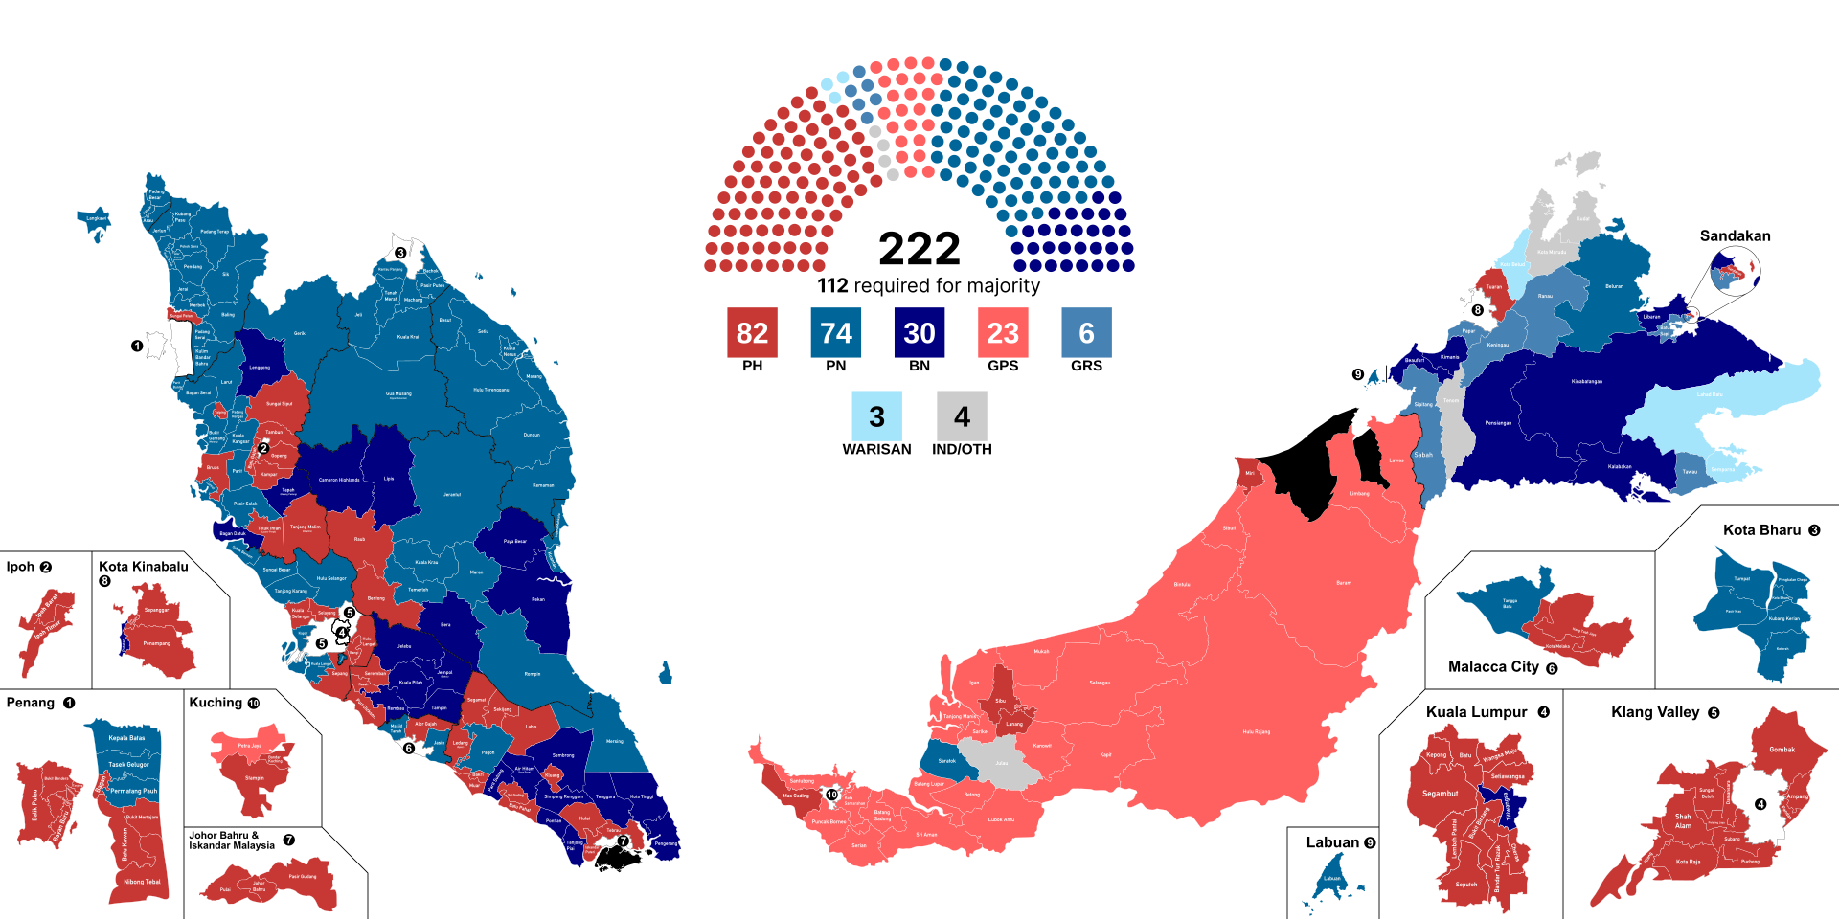

Slide 4
Understanding Malaysia’s electoral reform
Have progressed from “combatting cheating/fraud” to addressing systematic problems
Discourse are more substantive, but many missed opportunities. Though we have scored a few wins, major reforms remain outstanding
What is electoral system reform good for?
  Fairer votes
  Inclusive representation
  Stabilizing multiparty democracy

Slide 5
Bersih: from Street to Parliament
Coalition for Clean and Fair Elections (BERSIH) launched
BERSIH organized five public rallies to demand clean and fair elections
First democratic transition of power at the national level
Key members appointed to Electoral Reform Committee and Election Commission
Mixed results in lobbying for legislative and policy reforms on elections and institutions
2007-2016
2018-2020
2027?
2006
2018
2020-2024
Notes:
People Tribunal: Witness were called to give testimonies on the irregularity and incidents of fraud. Called for EC commissioners to resign due to the way the electoral boundaries were redrawn.
DART: to study and object any unfair redelineation. Working for two years, conducting research, training. Submit record breaking objection to EC when delineation exercise started in 2016. Manage to delay the calling of GE14
B4 demands: Free and Fair Elections, Clean Govt, Right to Dissent, Strengthening Parliamentary Democracy, Saving the Economy. B4 is a respond for 1MDB corruption cases by the then PM, Najib Razak

Slide 6
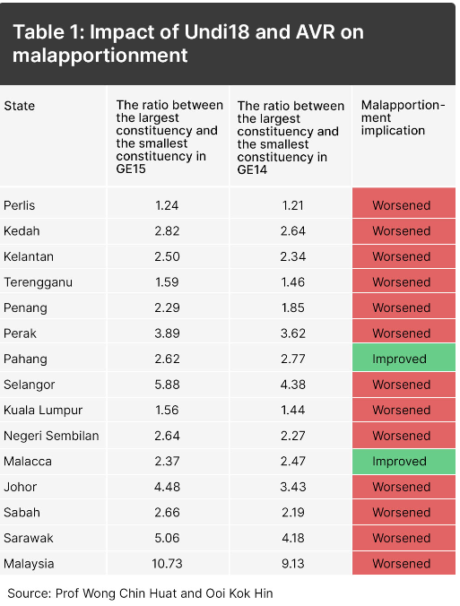
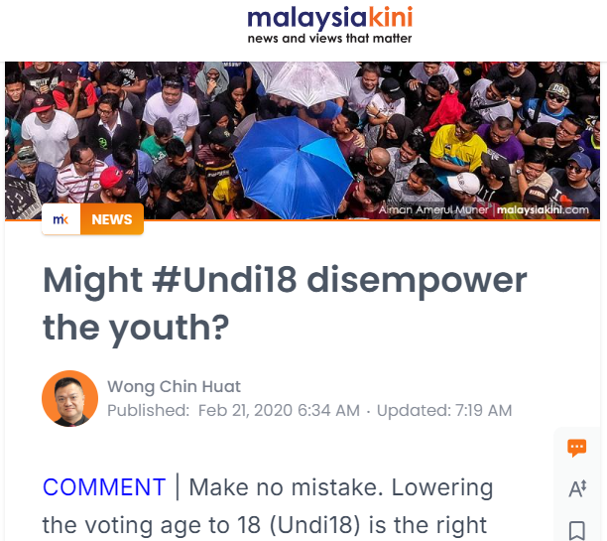

Slide 7
The stake
[domestic implication] Logic of FPTP electoral system + proliferation of political parties = volatile Winner-Takes-All
Question: can FPTP accommodate multiparty democracy?
[international significance] Strategic importance of Malaysia’s democratic transition
Southeast Asia lacks a successful democratization story for 30 years
Muslim-majority countries suffer from a lack of transition model after Tunisia and Arab Spring

Slide 8
Two broad categories
Electoral system reforms | Electoral procedure reforms
Moving away from pure FPTP to mixed system Local election Senate election Gender quota Anti-hopping Constituency size/Boundary change | Election laws Political financing Election Commission appointment Advance voting

Slide 9
Two broad categories
Electoral system reforms | Electoral procedure reforms
Moving away from pure FPTP to mixed system Local election Senate election Gender quota Anti-hopping Constituency size/Boundary change | Election laws Political financing Election Commission appointment Advance voting

Slide 10
Electoral system reforms
Electoral systems translate the votes cast in a general election into seats won by parties and candidates via three key variables i.e. electoral formula, ballot structure, district magnitude (International IDEA)

Slide 11
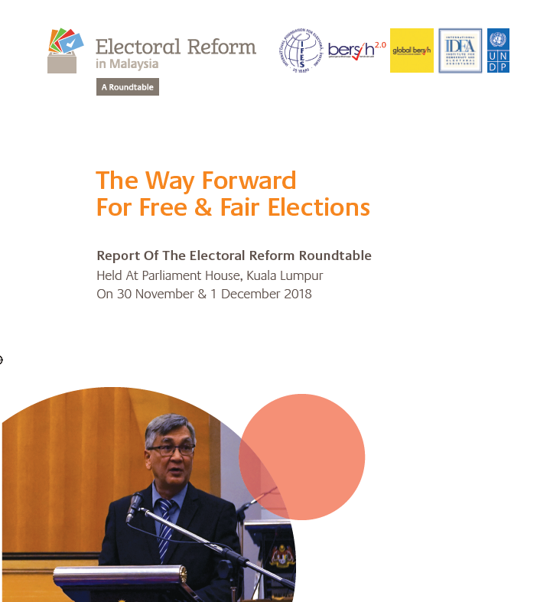
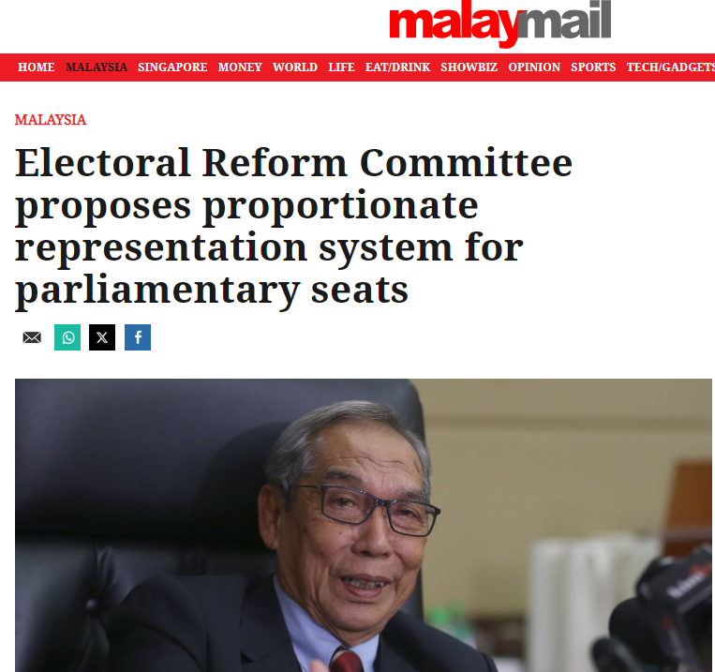
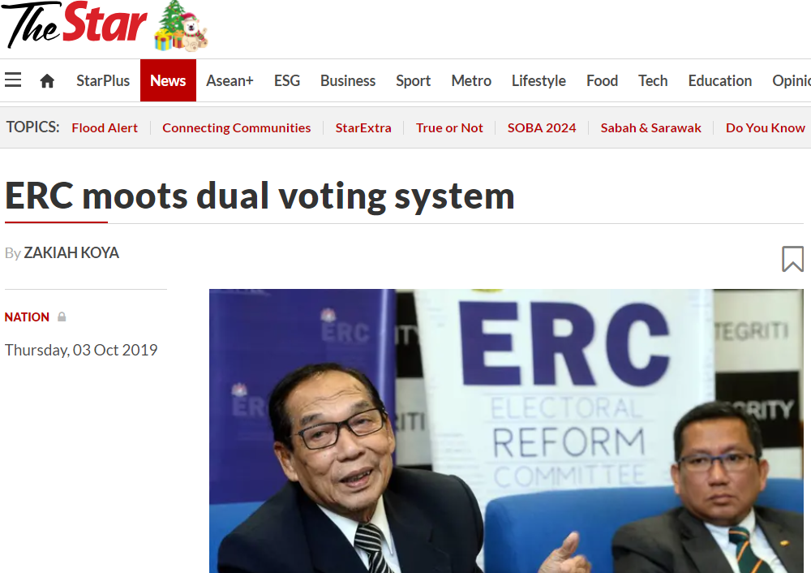
Introduce proportional representation

Slide 12
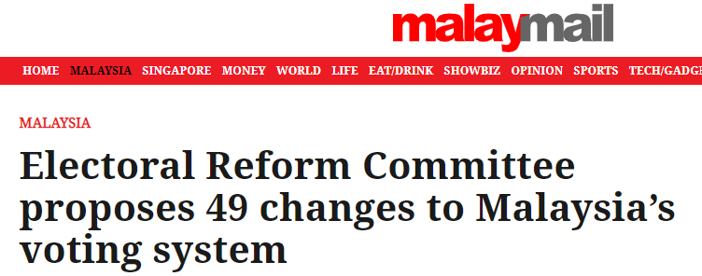
Post-GE14 window; ERC was our best bet at comprehensive electoral system reforms.
Bad timing: ERC completed its work BUT Sheraton move happened. Changed of political leadership > POS for reform disappeared > report and its 49 recommendations became classified state secrets
Prospect for change
  Big change
  Incremental/experimental change

Slide 13
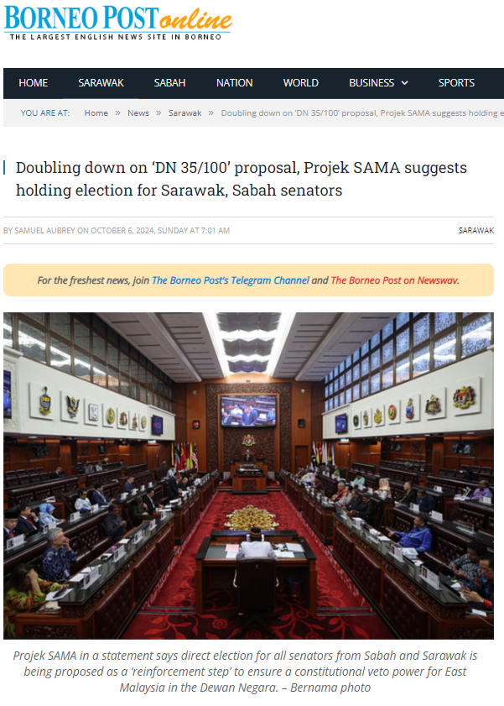
Senate election

Slide 14
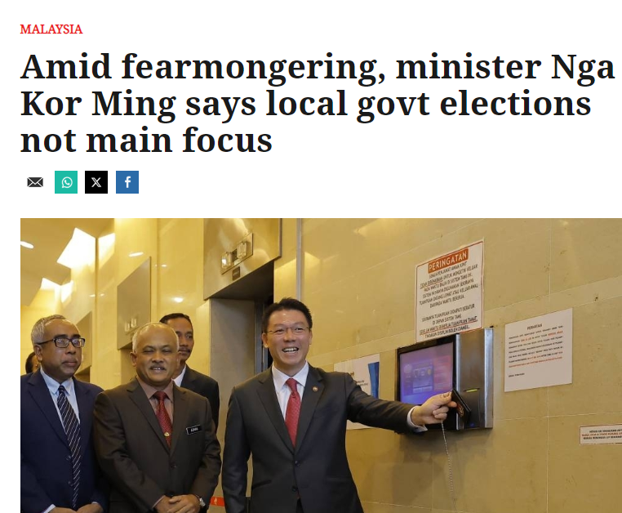
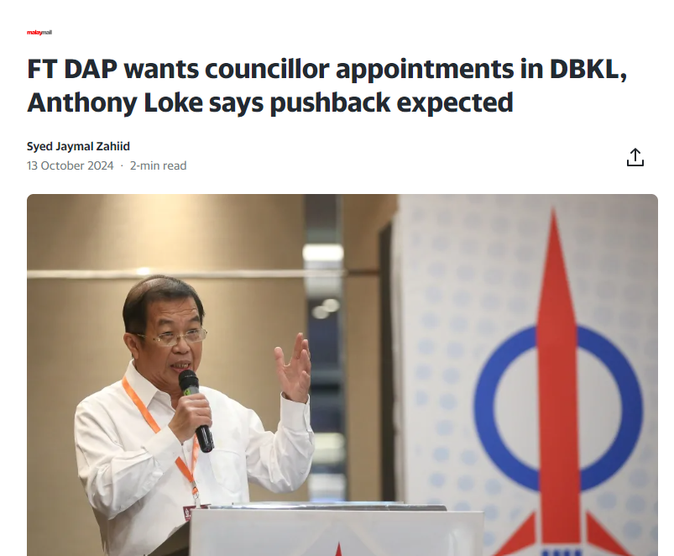
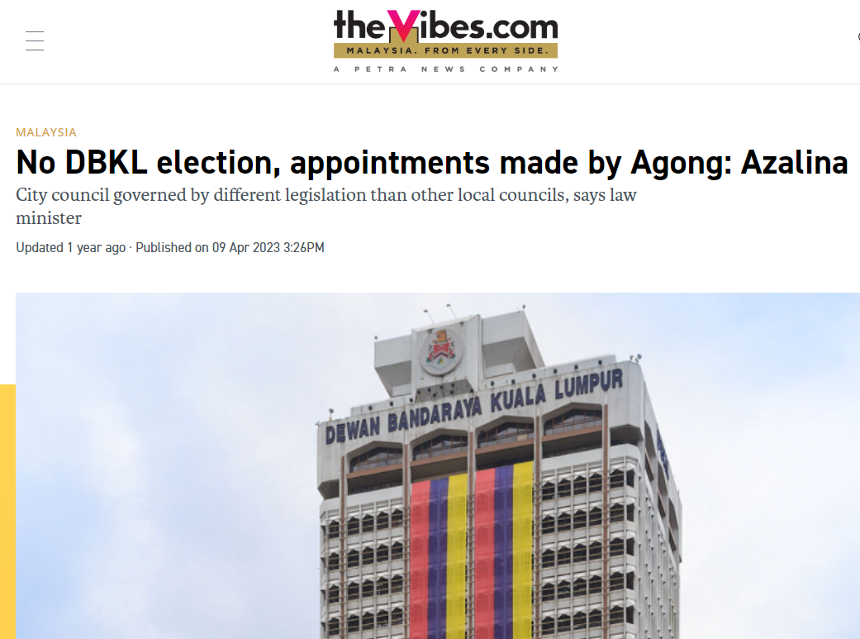
Local election

Slide 15
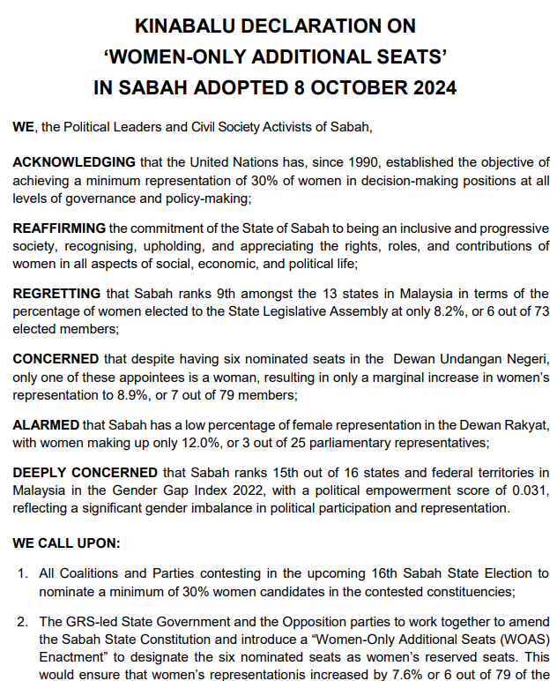
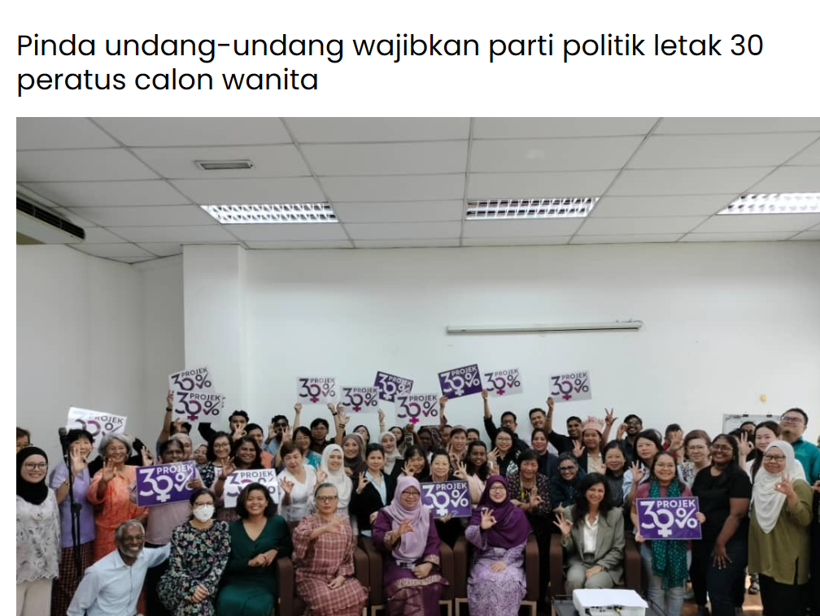
Gender quota

Slide 16
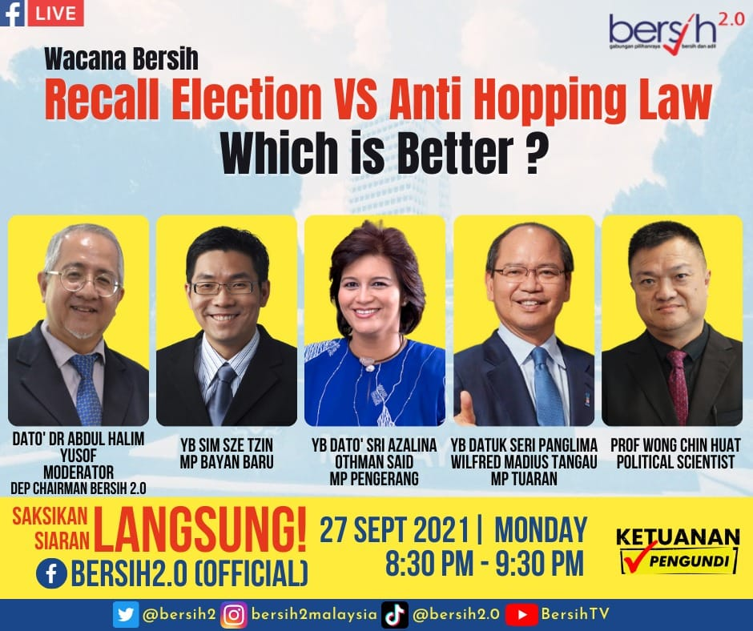
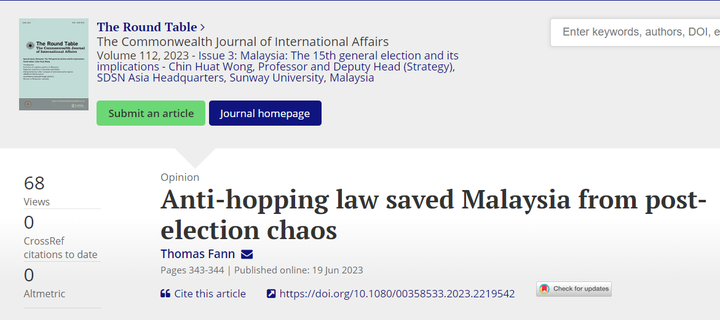
Advocated recall election, but settled for anti-hopping law

Slide 17
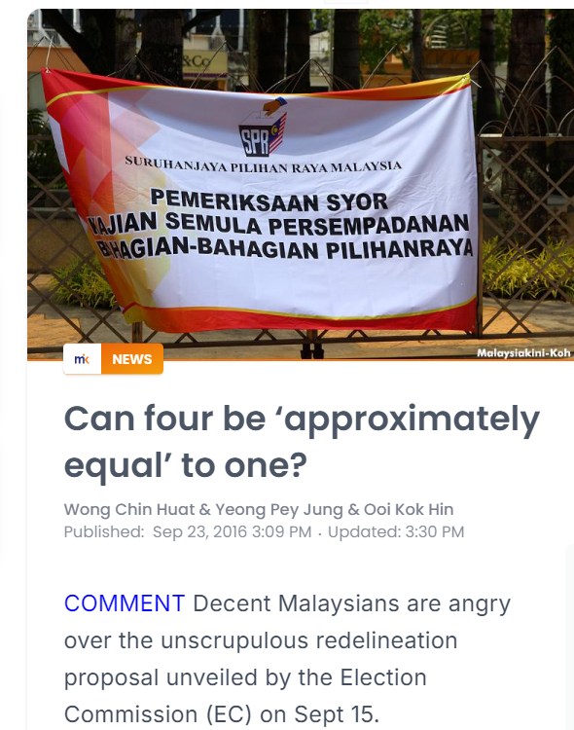
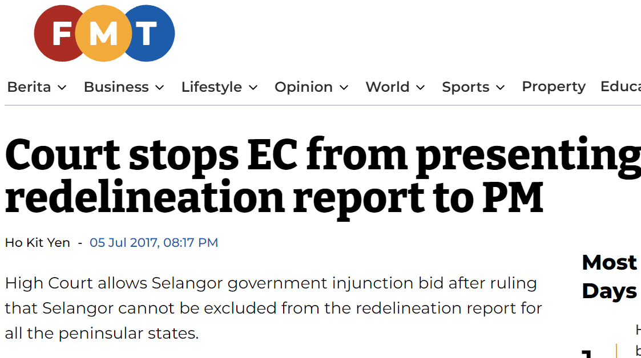
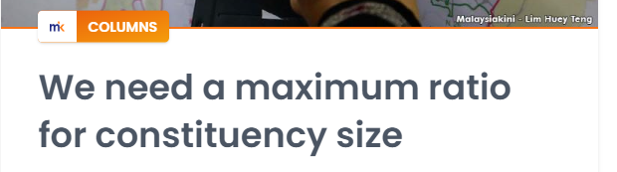
Constituency size

Slide 18
Electoral procedural reforms
Processes, institutions, and laws affecting elections

Slide 19
Two broad categories
Electoral system reforms | Electoral procedure reforms
Moving away from pure FPTP to mixed system Local election Senate election Gender quota Anti-hopping Constituency size/Boundary change | Election laws Political financing Election Commission appointment Advance voting

Slide 20
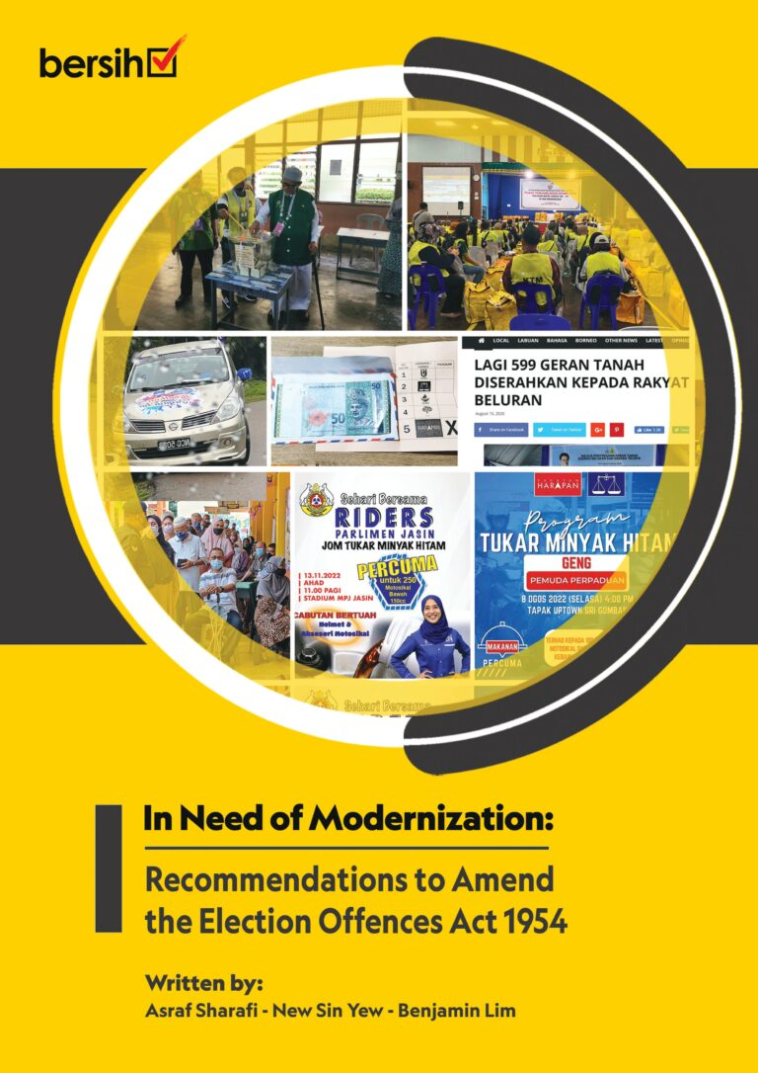
Election Law Reform
Issues with the law
Outdated
Unclear and ambiguous definition on certain major offences
Certain offences are not covered under the law
Bersih proposal
Propose amendment of the law – prepare amendment for the Election Offences Act
Introduce new offences such as abuse of state resources
Mandatory audit of election expenses (campaign finance report)
Increasing fine to RM10,000
Give more power to the EC – at least to fine the offender!

Slide 21

EC Appointment Process
Election Commissioner
Appointed by the King, as advised by the Prime Minister
No transparent process
No Parliamentary oversight
Impartiality and independence of the EC are often questionable
Bersih proposal and action plan
Produce TOR and submitted to the Prime Minister
Vetting process to appoint the EC before submitting the names to the King
Setting up a Parliamentary Standing Committee (permanent) on Election
PSC need to vet the candidate(s) list from the Prime Minister and conduct Parliamentary hearing to respond to the short-listed candidates.

Slide 22
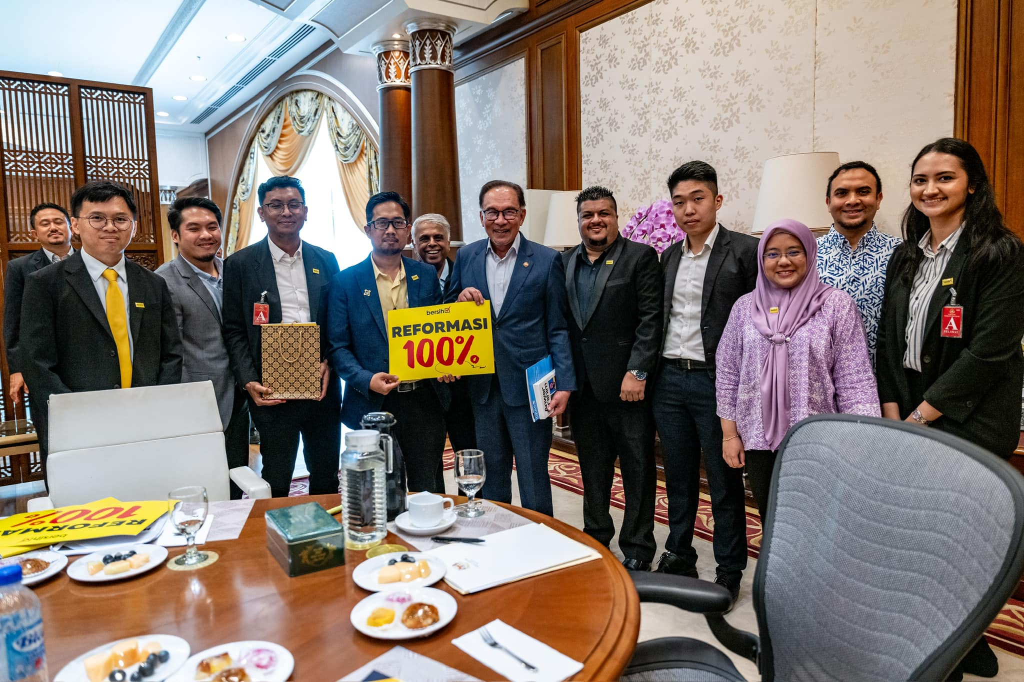
Bersih submit our 10-points memorandum to the Prime Minister

Slide 23
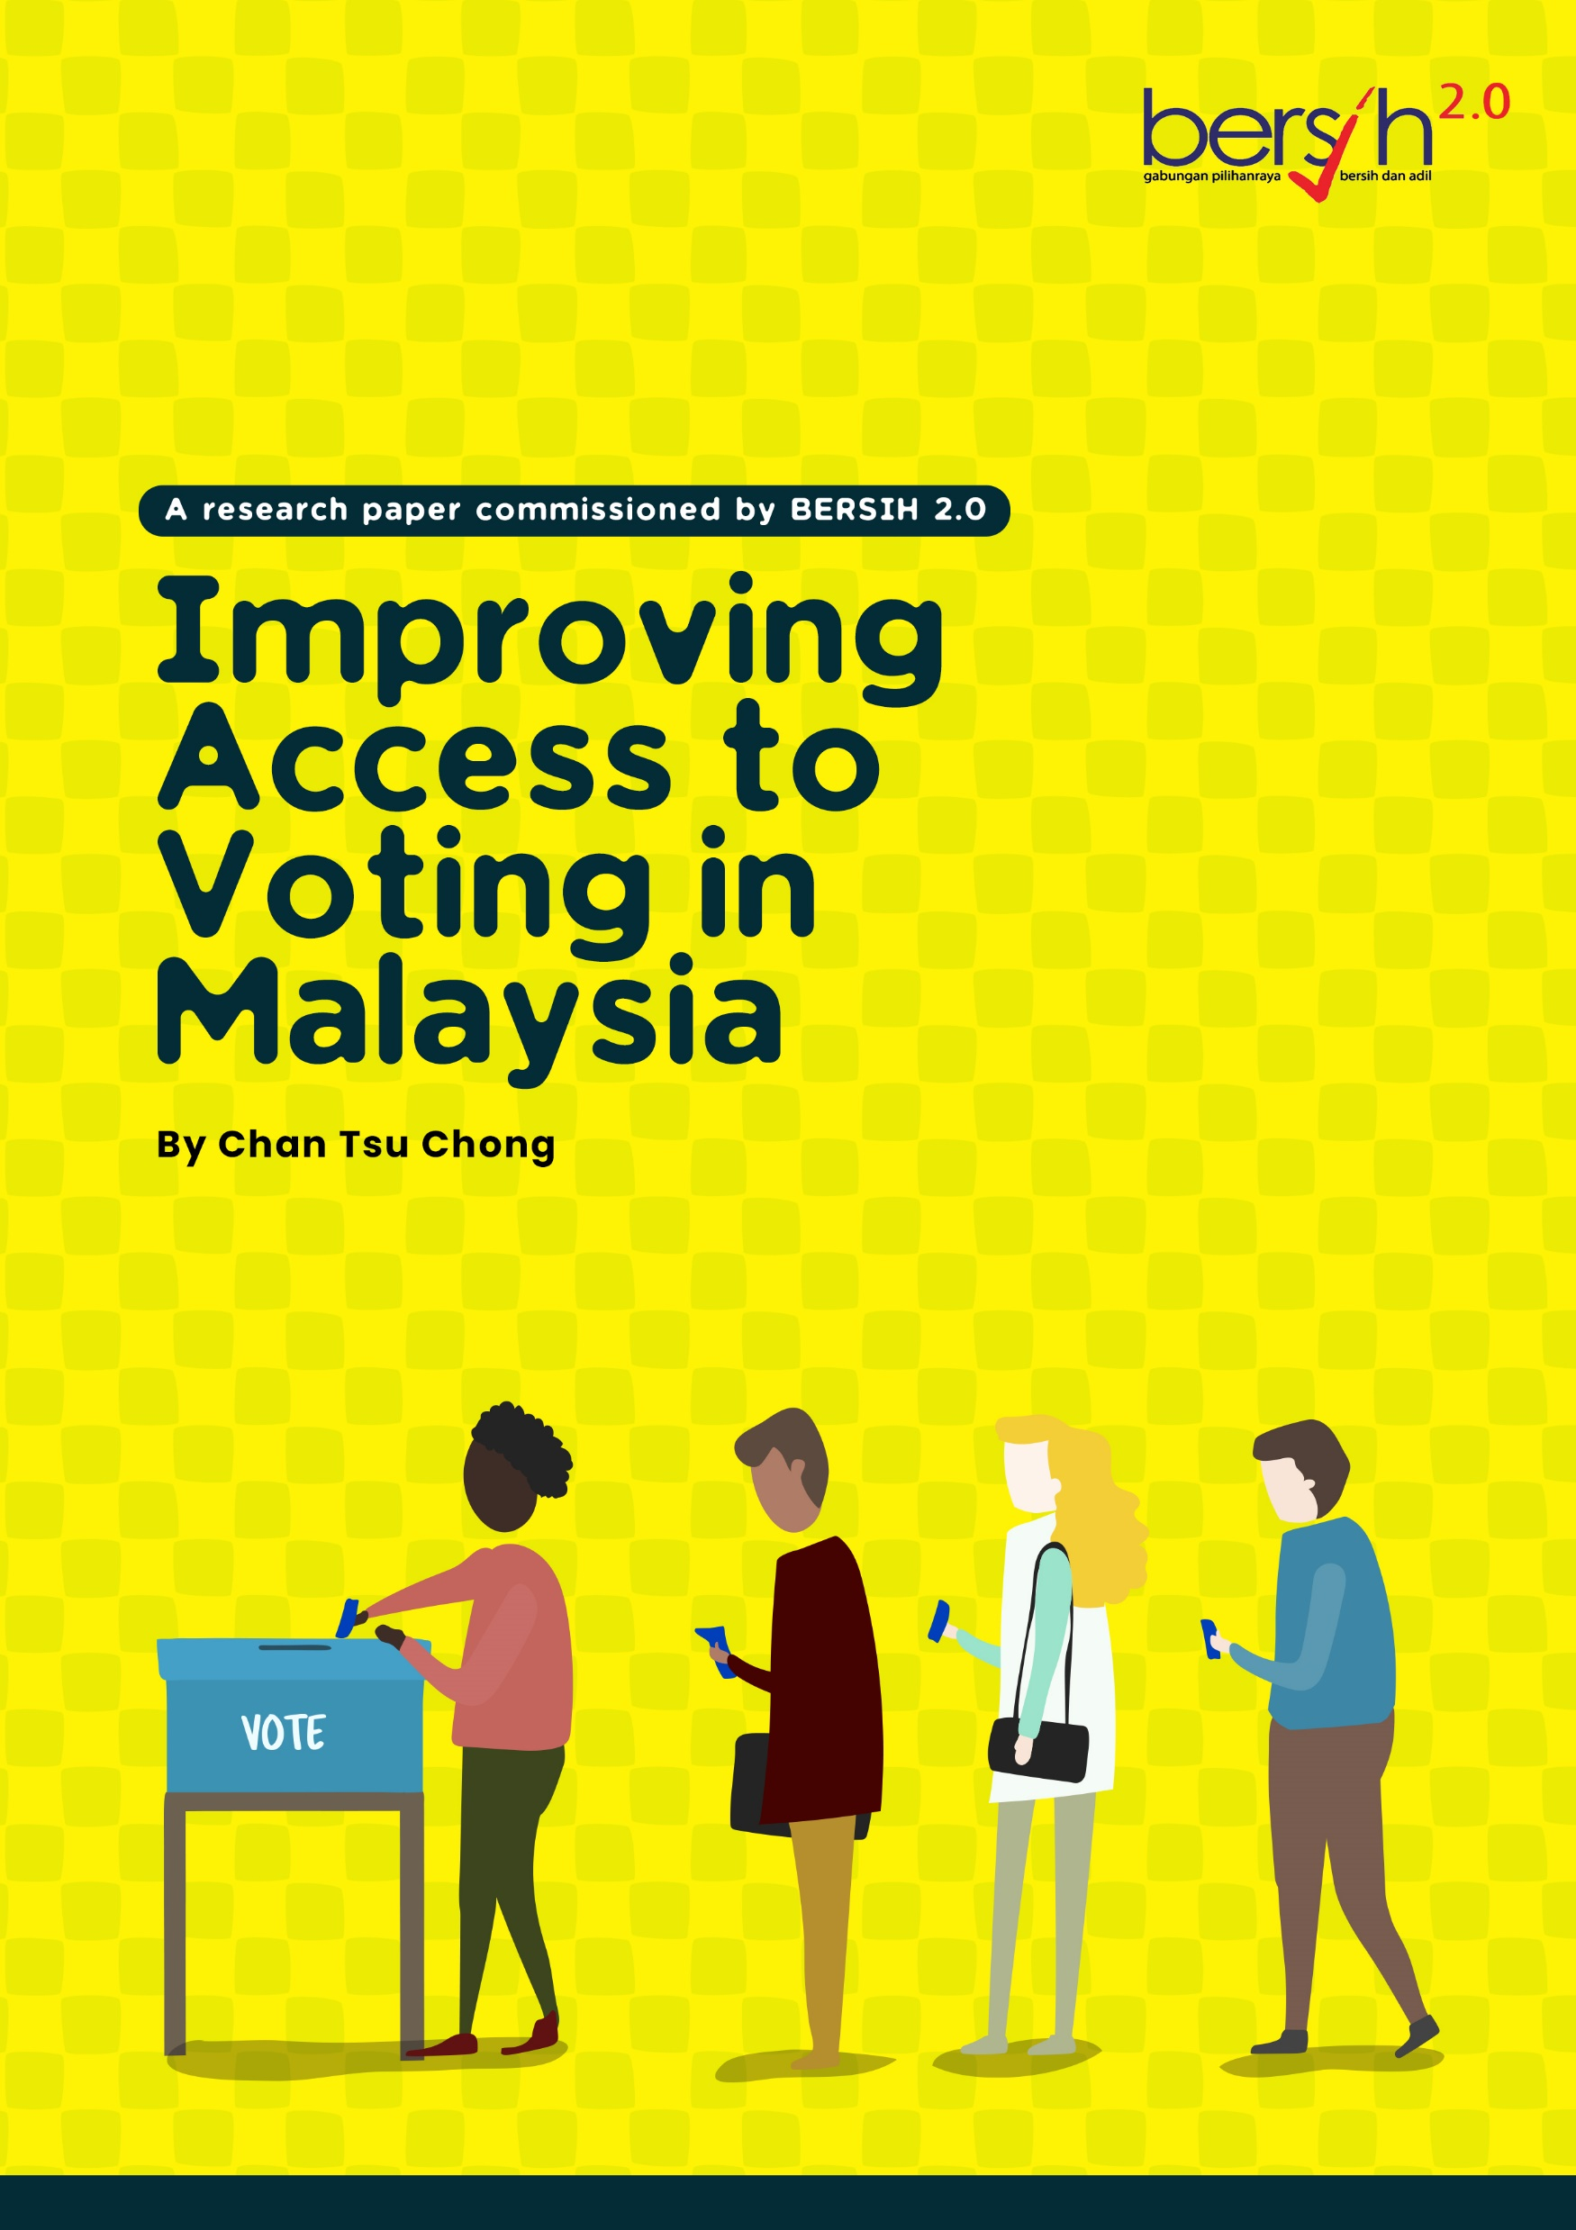
Increase access to voting
To whom?
Oversea Malaysians (improving postal voting system)
  Poor management of postal voting
  Lack of trust to the EC
Out of region voters (advance voting)
Person with Disabilities (PWD)
Proposal
Oversea Malaysians (improving postal voting system)
  Application process
  Self download with tight verification
  Self post to Malaysia
Out of region voters (advance voting)
  Expand the category to include out of region voters
  Vote in advance voting mega centre

Slide 24
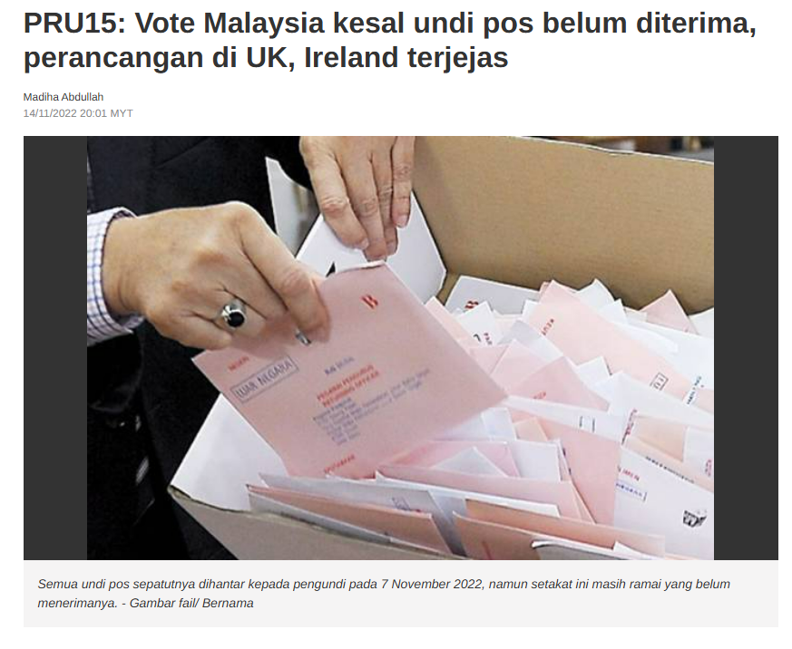
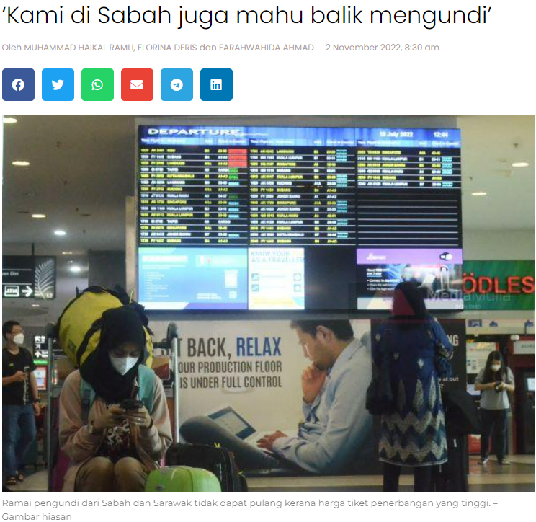

Slide 25

Political Financing
Issues
No law to regulate political financing
Minimum law to regulate campaign finances
Proposal and action plan
Building network, finding allies: CSO, MPs
Formation of All Party Parliamentary Group (APPG) on Political Financing
Producing propose bill of law on Political Financing

Slide 26
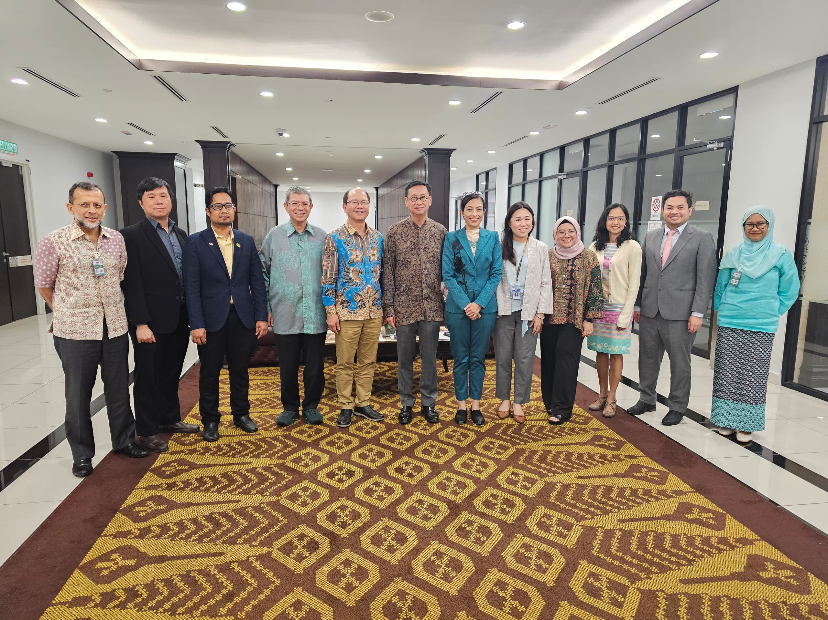
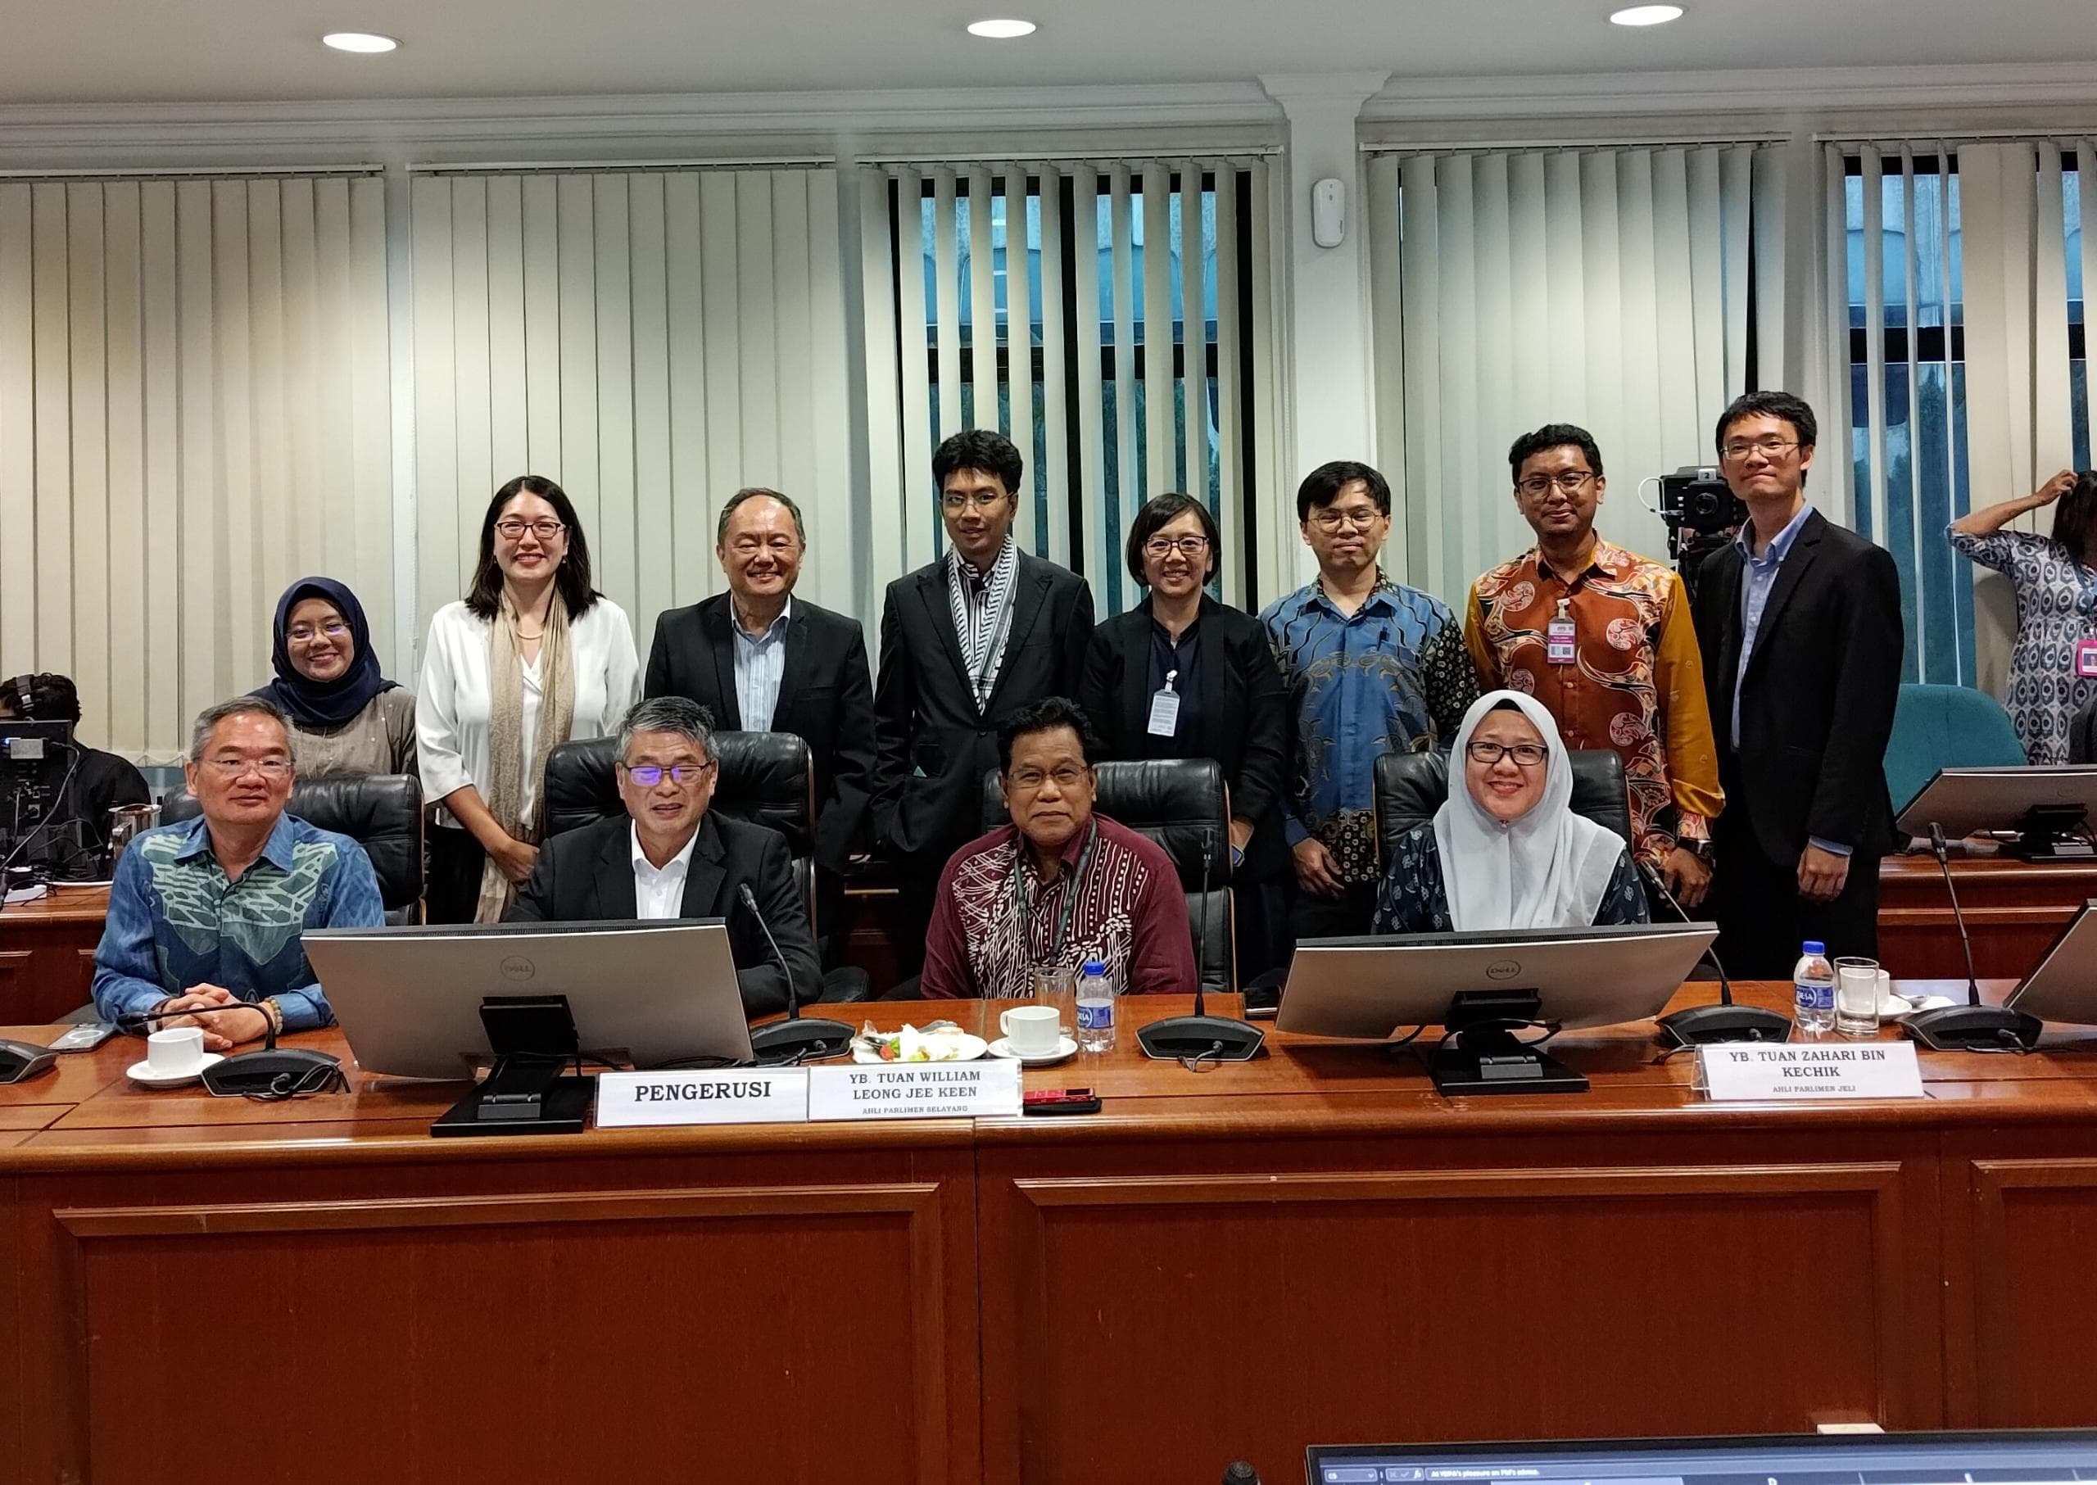

Slide 27
Concluding thoughts

Slide 28
After two decades, what electoral reforms have we achieved?
Achieved | Partially achieved | Outstanding
Indelible ink Increased voter turnout Automatic voter registration Anti-hopping law Election observation minimized cheating/fraud/errors Lowering voting age Mobilized public objection to unfair delineation | More inclusive election commissioners Expanded postal voting | Change to mixed electoral system Expand advance voting Overhaul election laws Fair delineation Reform appointments of EC Regulate political financing Local election Senate election

Slide 29
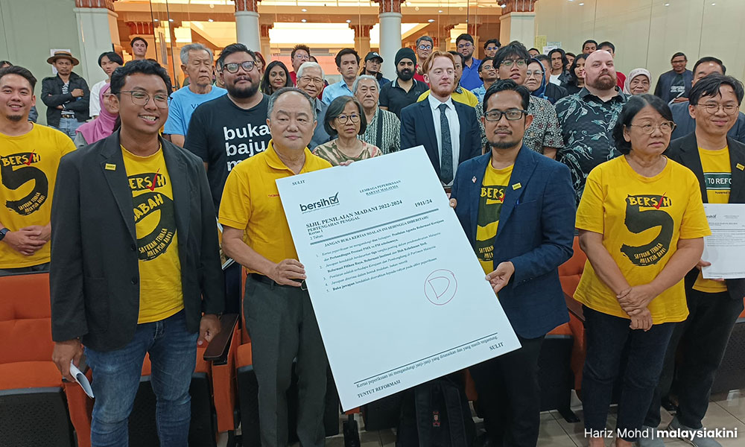
Lessons learned
Both mass collective action and high-level elite lobbying has its place in advocacy strategies. Sometimes we need mass action, but sometimes lobbying a small group of high-level decision-makers can result in a single legislation that’s impactful
The need to adapt strategic approach according to political environments e.g. 2018-2020, we suddenly have lot of allies in Gov’t/Par, new Opposition that is conservative, and a more open Election Commission
Agenda setting and thought leadership
Maintaining connections, build new political allies
Strategic partnership with media to make up for demobilized public
Putting ‘positive spins’ on ethnic framing & geographic/regional interests
Must be innovative to capture gov’t/media attention
Notes:
Allies:CSO member who contest in election, Opposition leader/member who assist in Bersih rally won the election and become an MP

Slide 30

Soalan/Komen/Suggestions
Emel asraf@bersih.org or kokhin@bersih.org

